Slide 1




1916 to 1923
Chapter 20
THE STRUGGLE FOR IRISH INDEPENDENCE
the struggle for irish independence
Strand Two: The History of Ireland
@MsDoorley

Slide 2
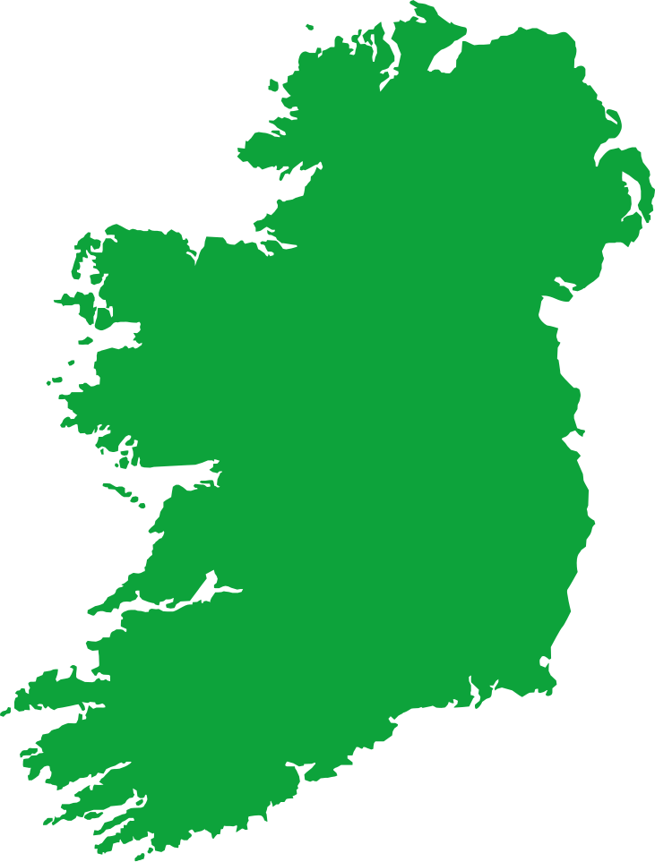
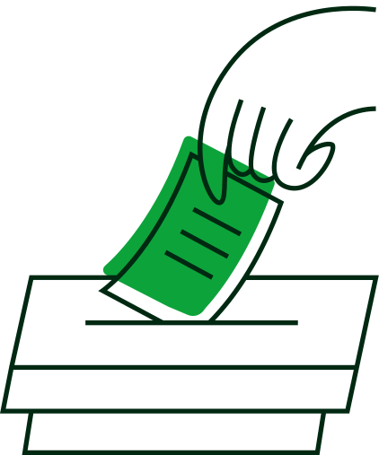


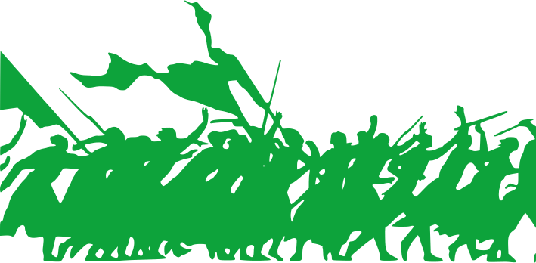
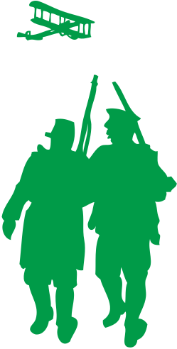

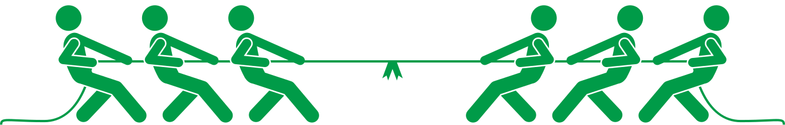
Chapter 20
THE STRUGGLE FOR IRISH INDEPENDENCE
Sinn Féin wins 73 seats in the General Election, showing public support for Irish Independence
The Anglo-Irish Treaty is signed by the Irish delegates in London, following 6 months of negotiations
The Irish Constitution, Bunreacht na hÉireann, is established.
1916
1918
1919
1921
1922
1937
1949
Strand Two: The Nature of History
Chapter Twenty: The Struggle for Irish Independence
Easter Rising takes place in Dublin and Cork, ending in failure
The War of Independence breaks out following the first Dáil Éireann on 21st January
The Irish Civil War takes place between the Anti-Treaty and Pro-Treaty factions.
The Republic of Ireland is established, completing full Irish independence from Britain.
@MsDoorley

Slide 3
Learning Outcomes
2.2 INVESTIGATE the role and significance of two leaders involved in the parliamentary tradition in Irish politics
2.4 EXAMINE the rise and impact of nationalism and unionism in Ireland, including key events between 1911 and 1923
2.5 IDENTIFY the causes, course and consequences of the Northern Ireland Troubles and their impact on North- South and Anglo-Irish relations
2.10 EXAMINE how one sporting, cultural or social movement impacted on Irish life
1.1 DEVELOP a sense of historical empathy by viewing people, issues and events encountered in their study of the past in their historical context
1.2 CONSIDER contentious or controversial issues in history from more than one perspective and DISCUSS the historical roots of a contentious or controversial issue or theme in the contemporary world
1.3 APPRECIATE their cultural inheritance through recognising historically significant places and buildings and DISCUSSING why historical personalities, events and issues are commemorated
1.4 DEMONSTRATE awareness of historical concepts, such as source and evidence; fact and opinion; viewpoint and objectivity; cause and consequence; change and continuity; time and space
1.7 DEVELOP historical judgements based on evidence about personalities, issues and events in the past, showing awareness of historical significance
Strand One: The Nature of History
Chapter Twenty: The Struggle for Irish Independence
@MsDoorley

Slide 4
Introduction
Between 1916 and 1921, Irish nationalists pursued both political and violent means in their attempted to achieve independence from Britain. The Easter Rising of April 1916 is among the most significant events in modern Irish. It was not a military success – but it became an inspiration to many other nationalists and increased support for an independent Irish republic.
Ireland would continue to struggle for independence using physical force throughout 1919-1921, eventually leading to the Anglo-Irish Treaty of 1921. This Treaty split both the Dáil and the IRA, resulting in the outbreak of a civil war and one of the worst periods of bloodshed in Irish history.
Strand Two: The History of Ireland
Chapter Twenty: The Struggle for Irish Independence
@MsDoorley

Slide 5
1916-1923
Chapter 20
20.1: PLANNING THE RISING
20.1: planning the rising
Strand Two: The History of Ireland
@MsDoorley

Slide 6
Preparations
The Irish Republican Brotherhood (IRB) had infiltrated many organisations in Ireland such as the GAA, Sinn Féin and the IVF. Following the outbreak of World War I, the IRB leaders began to plan a rising as Home Rule had been put on hold - ‘Britain’s difficulty was Ireland’s opportunity’ - believing that Britain was distracted elsewhere and this would be the perfect time to strike.
The IRB formed a secret Military Council to organise the Rising. Its members included: Thomas Clarke, Seán MacDiarmada, Pádraig Pearse, Joseph Plunkett, Éamonn Ceannt and Thomas McDonagh. The Council was secret due to the danger of infiltration by spies for the British government.
The Military Council needed weapons, which were funded largely from Irish-Americans. Jospeh Plunkett and former British diplomat Sir Roger Casement used money to buy weapons from Germany. The Council agreed that the Rising would begin on Easter Sunday, 23rd April 1916. Not only was it because a holiday period but also because Pearse believed in blood sacrifice; they would give up their lives for the good of the future of Ireland like Christ sacrificed his life on the Cross.
The Council learned that James Connolly, the socialist leader of the Irish Citizen Army, was also preparing a rising. Connolly had helped protect strikes during the Strike and Lockout of 1913. He co-founded the Labour Party in 1912. In January 1916, the Military Council convinced Connolly to join the two groups together.
Strand Two: The History of Ireland
Chapter Twenty: The Struggle for Irish Independence
Diagram taken from Artefact, 2nd Edition by Eimear Jenkinson and Gregg O'Neill (educate.ie)
@MsDoorley

Slide 7
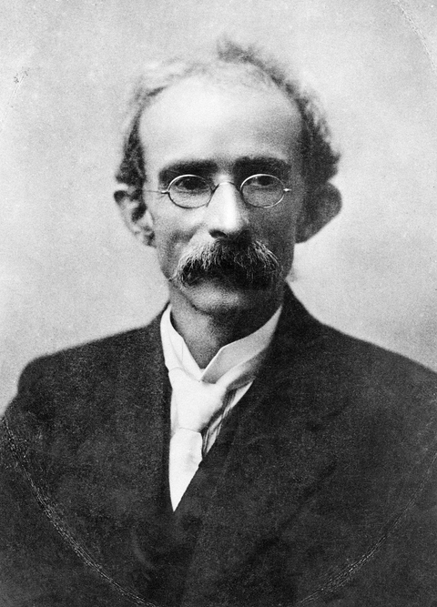
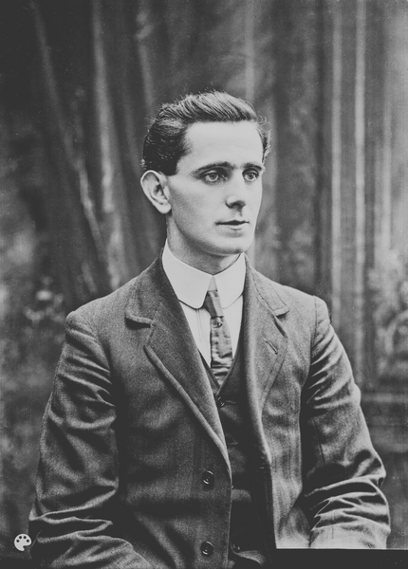
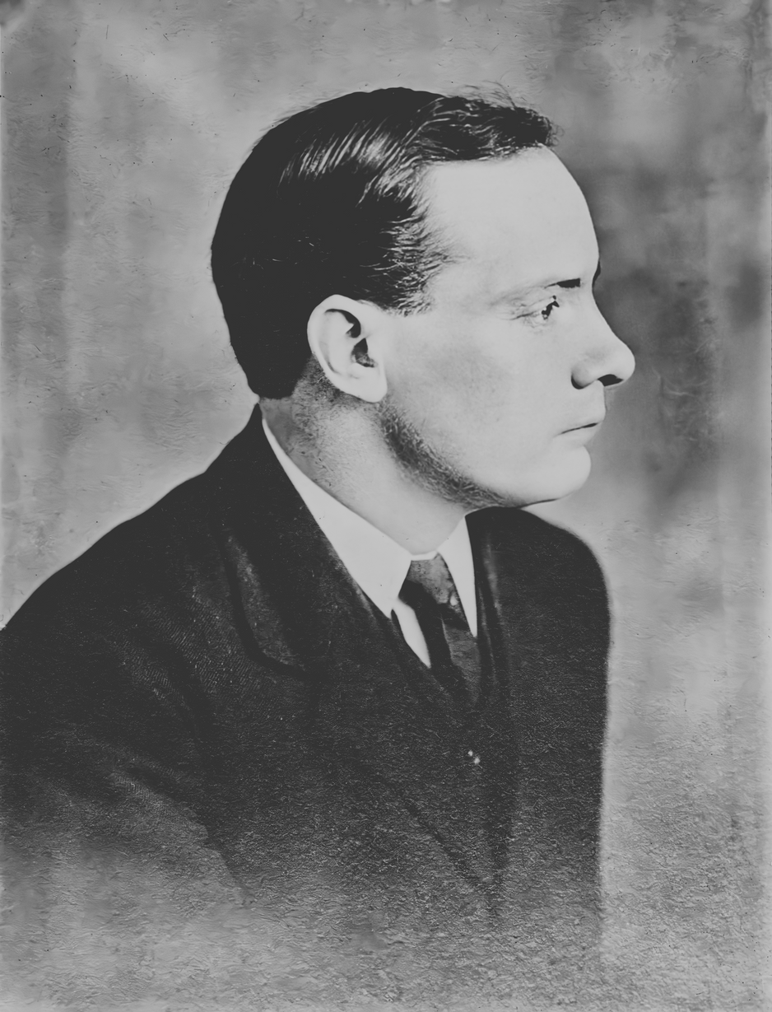
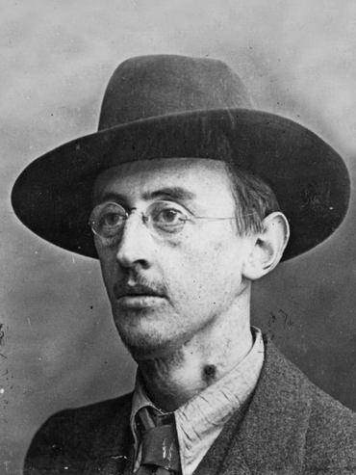
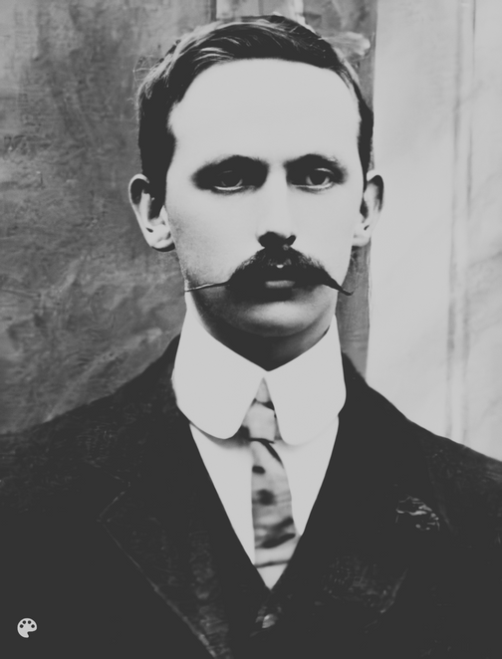
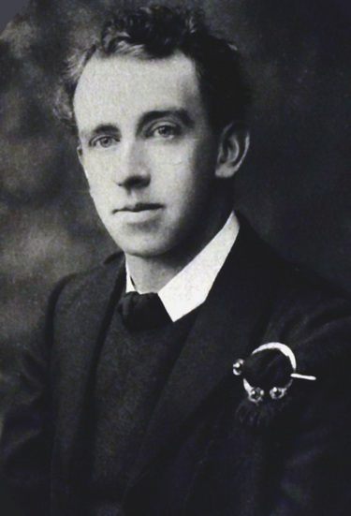
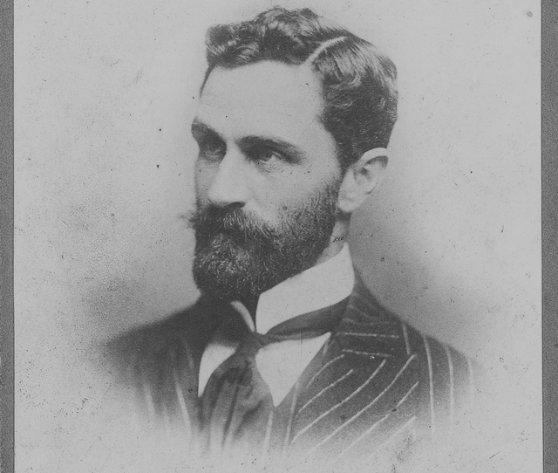
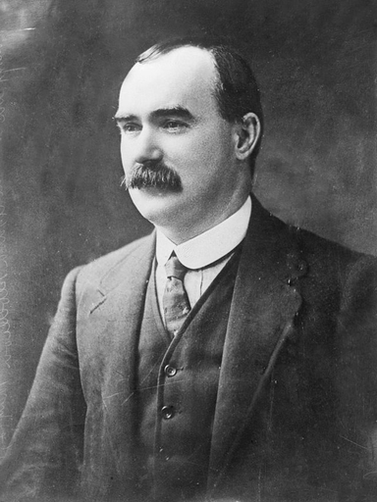
Thomas Clarke
Seán MacDiarmada
Pádraig Pearse
Joseph Plunkett
Strand Two: The History of Ireland
Chapter Twenty: The Struggle for Irish Independence
Éamonn Ceannt
Thomas MacDonagh
Roger Casement
James Connolly
Diagram taken from Artefact, 2nd Edition by Eimear Jenkinson and Gregg O'Neill (educate.ie)
@MsDoorley

Slide 8
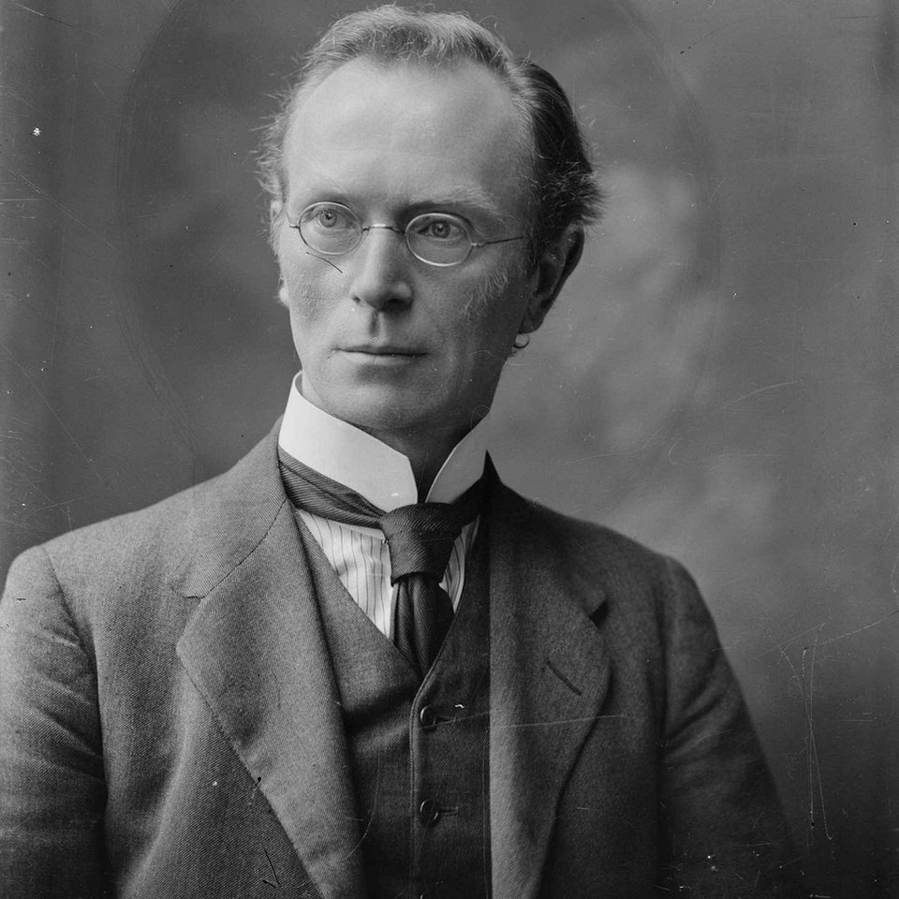
The involvement of the Irish Volunteers
Eoin MacNeil didn’t know about the plans for the IRB rising and was preparing his volunteers for rebellion. MacNeill was not a member of the IRB and had been opposed to the idea of a rebellion. He believed that the Irish Volunteers could only justify fighting if they were first attacked by the British government. The Military Council knew that for the Easter Rising to be a success, they would need MacNeill and the Irish Volunteers. Joseph Plunkett forged a document (the Castle Document) saying that the Irish Volunteers were to be arrested by the British military, which had been written on Dublin Castle paper. Mac Neil fell for it and put the Volunteers on high alert. The Rising was set for Easter Sunday 1916, April 23rd.
Strand Two: The History of Ireland
Chapter Twenty: The Struggle for Irish Independence
@MsDoorley

Slide 9
The Plans go wrong
The Easter Rising was planned as a nationwide rebellion. German guns and ammunition was due to land in Co. Kerry on Easter Sunday on a ship called The Aud. It was captured off the coast of Kerry 3 days earlier and the captain sank it rather than hand over the 20,000 rifles to the British navy. Sir Roger Casement, who had been travelling in a German submarine, was also captured, arrested and taken to a British prison where he was later tried for treason and hanged.
MacNeil discovered that the Castle Document was a forgery so he cancelled the participation of the Irish Volunteers by placing a notice in the Sunday Independent, ordering the Volunteers to not to take part in the rising.
Any chance of success was fading. However, the Military Council decided to go ahead with the Rising.
Strand Two: The History of Ireland
Chapter Twenty: The Struggle for Irish Independence
Diagram taken from Artefact, 2nd Edition by Eimear Jenkinson and Gregg O'Neill (educate.ie)
@MsDoorley

Slide 10
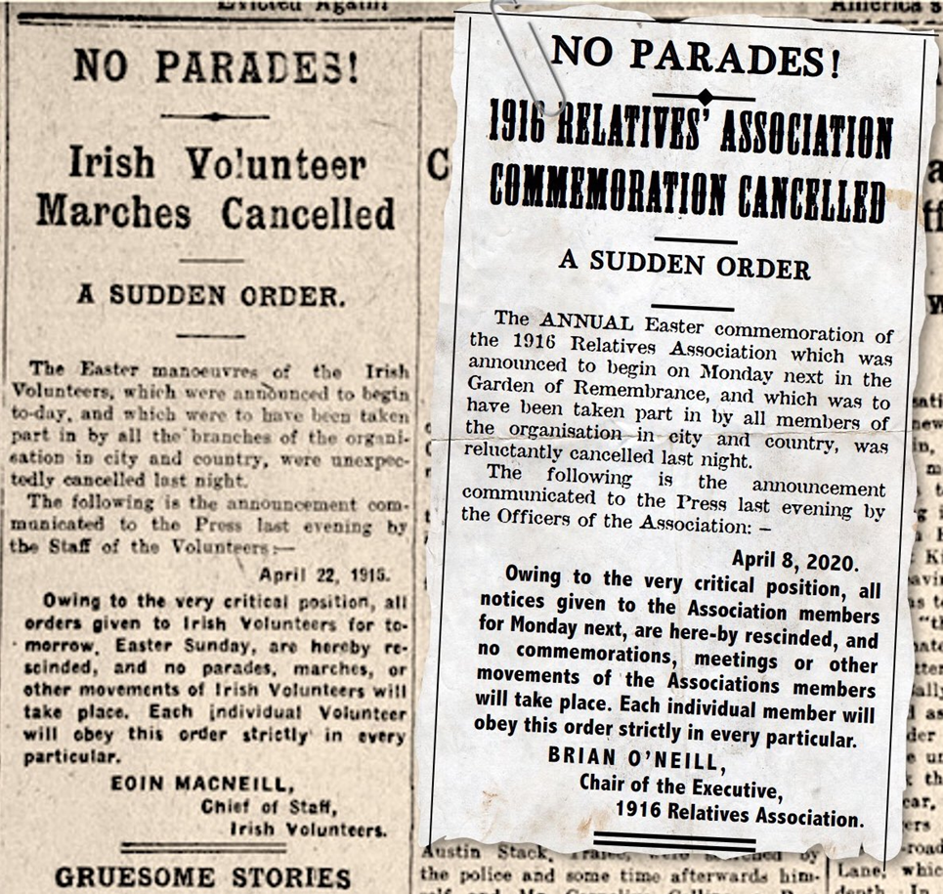
Strand Two: The History of Ireland
Chapter Twenty: The Struggle for Irish Independence
Diagram taken from Artefact, 2nd Edition by Eimear Jenkinson and Gregg O'Neill (educate.ie)
@MsDoorley

Slide 11
Checkpoint pg. 215 (Artefact, 2nd Edition)
  Explain the term; blood sacrifice
  What was the role of the Military Council in planning the Rising?
  What support from outside Ireland did the Rebels get?
  Describe the purpose of the Castle Document.
  How did the plans for the Rising fall apart during Easter Week?
Strand Two: The Nature of History
Chapter Twenty: The Struggle for Irish Independence
@MsDoorley

Slide 12
Checkpoint pg. 215 (Artefact, 2nd Edition)
1. Blood sacrifice: they would give up their lives for the good of the future of Ireland.
2. The role of the Military Council was to secretly organise a rising.
3. Support from outside Ireland included funds from Irish-Americans. Joseph Plunkett and the Irishman and former British diplomat Sir Roger Casement used the money to buy arms and ammunition from Germany.
4. The purpose of the Castle Document was to convince Eoin MacNeill and the Irish Volunteers to support the Rising, by showing MacNeill a forged document on Dublin Castle paper stating that the British government planned to disarm the Irish Volunteers.
5. The Aud was captured by the British navy in Tralee Bay on the Friday before Easter, sunk by its captain and all 20,000 rifles were lost. Also, Casement, who had been travelling in a German submarine, was captured. Finally, Eoin MacNeill found out that the Castle Document was a forgery and cancelled the Irish Volunteers’ participation in the Rising.
Strand Two: The Nature of History
Chapter Twenty: The Struggle for Irish Independence
@MsDoorley

Slide 13
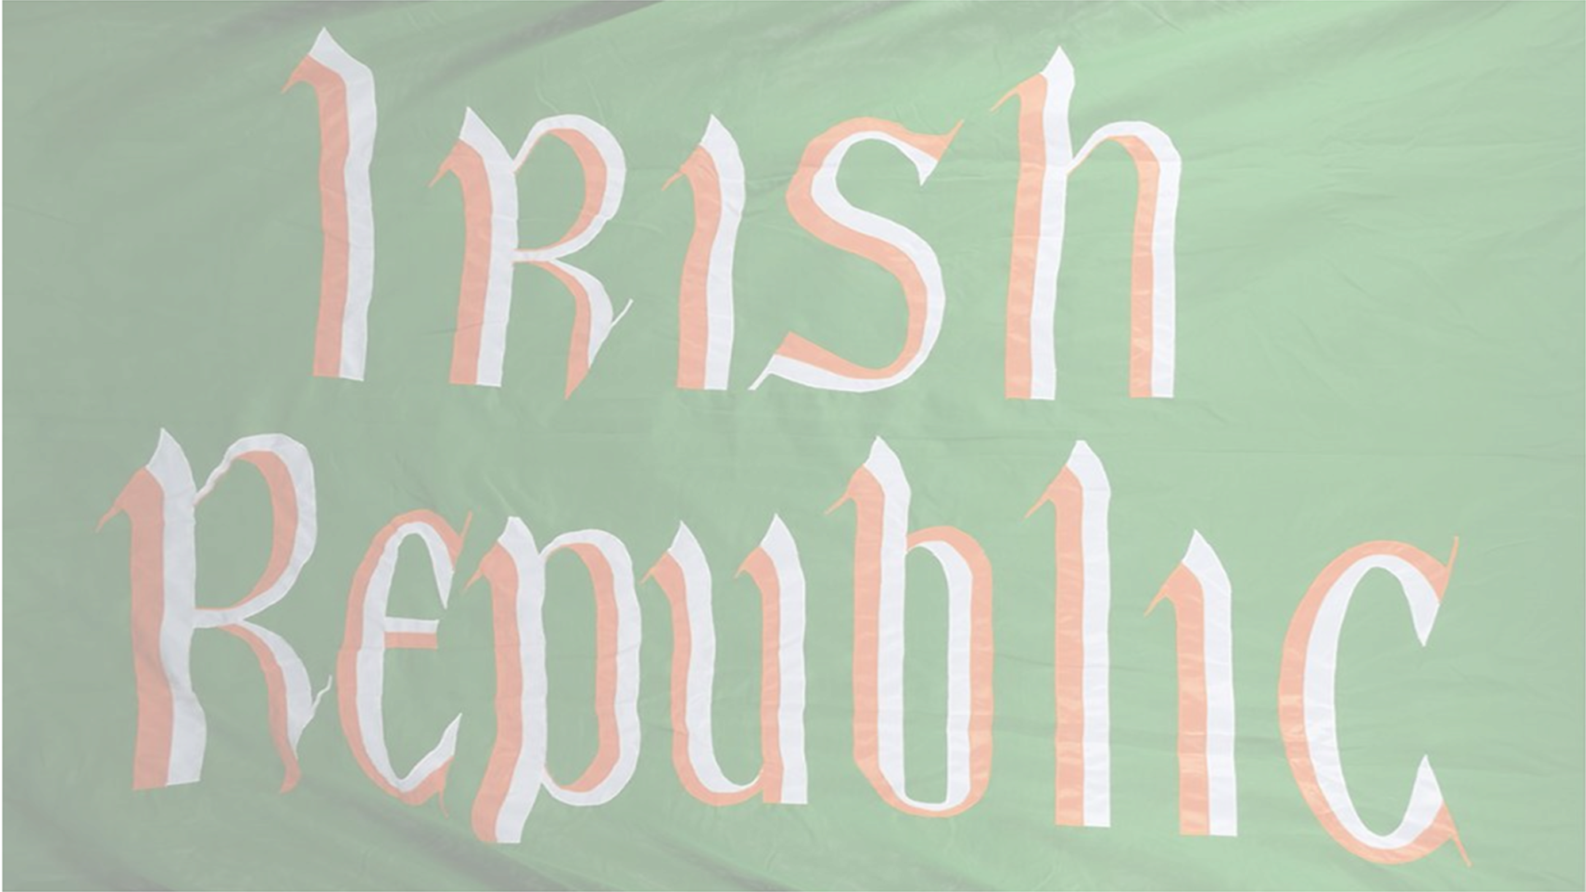
1916-1923
Chapter 20
20.2: THE 1916 EASTER RISING
20.2: the 1916 easter rising
Strand Two: The History of Ireland
@MsDoorley

Slide 14
The Rising Goes Ahead
The Military Council went ahead with the Rising on Easter Monday, 24th April 1916. Pearse felt that the British would not expect this after the loss of the Aud. As it was a bank holiday Monday, many British soldiers based in Dublin had the day off. Only Dublin Volunteers could be gather on such short notice, so the Rising was now mainly confined to the capital. By now the rebels knew it would be a military failure, but they hoped that their blood sacrifice would inspire people.
On Easter Monday morning, about 1,500 members of the Irish Volunteers and the Irish Citizen Army marched from the ITGWU headquarters in Liberty Hall to various city centre buildings. The locations they occupied included the General Post Office (GPO), Boland’s Mill, Jacobs Factory, the Four Courts, the South Dublin Union, the Mendicity Institution, St Stephen’s Green and the Royal College of Surgeons.
Pearse and Connolly occupied the GPO and made it the headquarters of the Rising. Outside the GPO, Pearse read the Proclamation of the Irish Republic announcing that they were setting up a provisional (temporary) government replacing Britain's control in Ireland. At the time, many people walking by did not grasp the importance of this evet; some even thought it was a play.
Strand Two: The History of Ireland
Chapter Twenty: The Struggle for Irish Independence
Diagram taken from Artefact, 2nd Edition by Eimear Jenkinson and Gregg O'Neill (educate.ie)
@MsDoorley

Slide 15
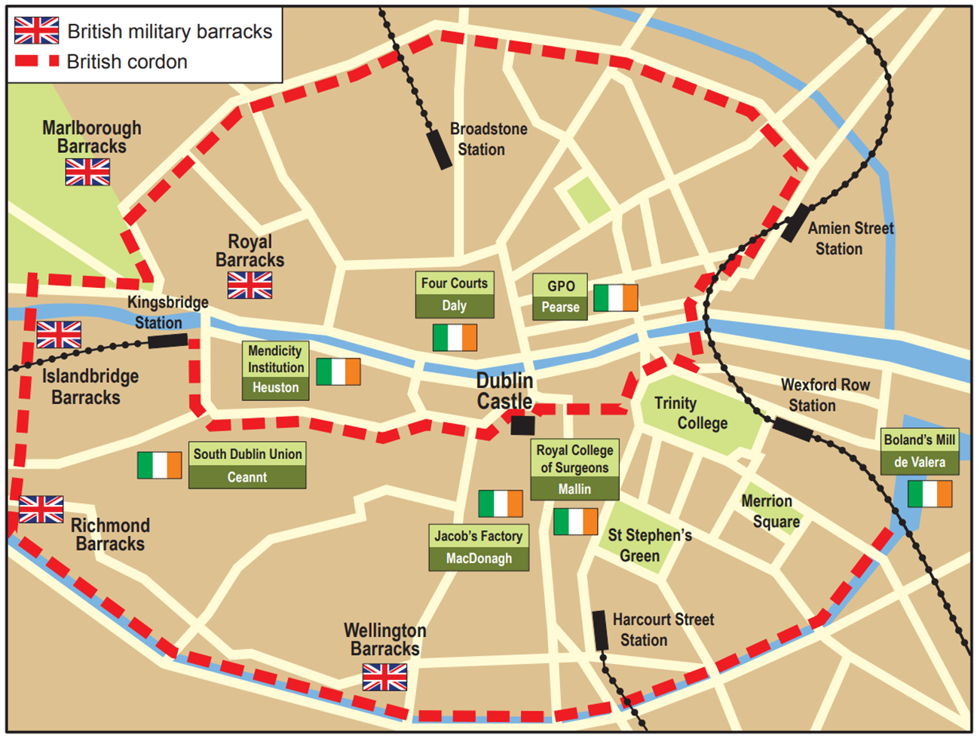
Strand Two: The History of Ireland
Chapter Twenty: The Struggle for Irish Independence
Diagram taken from Artefact, 2nd Edition by Eimear Jenkinson and Gregg O'Neill (educate.ie)
@MsDoorley

Slide 16
Britain's Response
The British government was taken by surprise. Only 400 British soldiers were on duty that Easter Monday. However, extra soldiers were quickly brought in from the Curragh barracks in Co. Kildare and from England through ports such as Dún Laoghaire. By Tuesday evening, there were 1500 rebels left against over 6,500 British troops. On Wednesday, the rebels in the GPO were heavily shelled by field guns in the streets and from the Helga boat on the River Liffey.
As the week went on, the British gained control , with pockets of rebels surrounded within buildings and spaces such as St Stephen's Green and had no means of contacting each other. The only minor victory was at Mount St. Bridge where 13 rebels held up some 1,750 soldiers for hours, killing or wounding 231 British soldiers before being overwhelmed.
By Friday, it was clear that the rebels had been defeated. The city centre was in ruins, the rebels were surrounded and looting was occurring all over the city. Civilian casualties were very high – 54% of total deaths were civilians, 16% were Rebels and 30% were British soldiers. Civilians in Dublin resented the destruction of their city and looting caused some casualties.
Pearse surrendered unconditionally on Saturday. A nurse named Elizabeth O’Farrell, who had tended to the injured inside the GPO, went as messenger to the British General. News of the surrender spread and the Rising was over by Monday 1st May 1916.
Strand Two: The History of Ireland
Chapter Twenty: The Struggle for Irish Independence
@MsDoorley

Slide 17
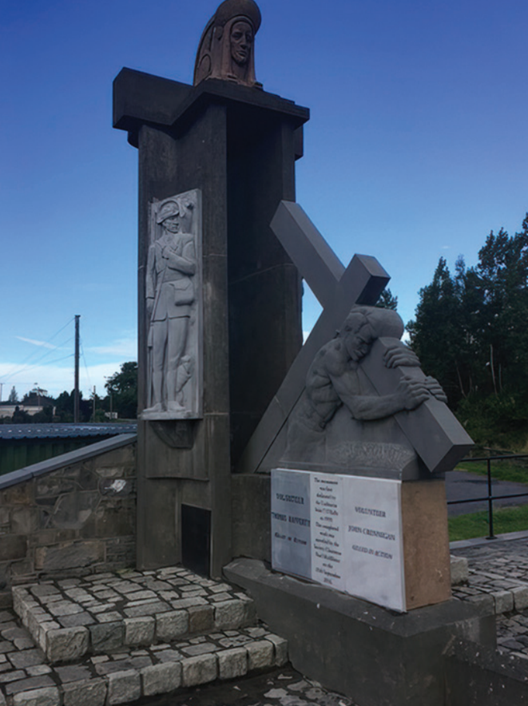
Why the Rising failed
There was a lack of weapons and ammunition
Only a small number of Irish fighters took part
There was much confusion leading up to the Rising
Britain had greater numbers of soldiers and better weapons.
The rebels based themselves in areas that could be easily surrounded
Many civilians did not realise the significance of the events until afterwards
It was not the countrywide rebellion that was intended
Strand Two: The History of Ireland
Chapter Twenty: The Struggle for Irish Independence
Diagram taken from Artefact, 2nd Edition by Eimear Jenkinson and Gregg O'Neill (educate.ie)
@MsDoorley

Slide 18
Pádraig Pearse, 1879-1916
Pádraig Pearse was born into a family of stonemasons on Great Brunswick Street (now Pearse Streat), Dublin. He joined the Gaelic League in 1896 and later became the editor of its paper, An Claidheamh Soluis, and a committee member. He lectured in Irish at UCD. Pearse set up a bilingual school for boys, St Enda's, in 1908. In 1910, the school moved to Rathfarnham, where it now hosts the Pearse Museum. He was elected to the Irish Volunteer's provisional committee in 1913 and later became its Director of Organisation. In July 1914, Pearse was involved in the Howth gun-running, and hid the stash at St Enda's. He was on the Military Council that planned the Rising and was a signatory of the Proclamation. Pearse read the Proclamation of the Irish Republic aloud on the steps of the GPO. He was executed on 3rd May 1916 at Kilmainham Gaol and buried at Arbour Hill.
Strand Two: The History of Ireland
Chapter Twenty: The Struggle for Irish Independence
Diagram taken from Artefact, 2nd Edition by Eimear Jenkinson and Gregg O'Neill (educate.ie)
@MsDoorley

Slide 19
Checkpoint pg. 219 (Artefact, 2nd Edition)
  Why was the decision taken to go ahead with the Rising?
  Look at the map on the occupied locations of the Rising. What do you think the Rebels were trying to achieve with the buildings they occupied? Look at their names and locations.
  Who read the Proclamation of the Irish Republic outside the GPO?
  Give two examples of the British response to the Rising.
  Look at the table above on why the Rising failed. Which of these reasons do you think is the most significant? Explain your answer.
Strand Two: The Nature of History
Chapter Twenty: The Struggle for Irish Independence
@MsDoorley

Slide 20
Checkpoint pg. 219 (Artefact, 2nd Edition)
1. The Rising went ahead because Pearse felt that the British would not expect this after the loss of the Aud, and as it was a bank holiday Monday, many British soldiers based in Dublin had the day off. Knowing that it would be a military failure did not deter him; he felt that the ‘blood sacrifice’ would have a powerful effect.
2. The rebels were trying to spread their fighting around the city in different areas, maybe to split up the British forces in many areas. They were also using main landmarks/buildings in the city and may have been taking into account that British reinforcements would probably arrive at the harbours and train stations.
3. Pádraig Pearse read the Proclamation of the Irish Republic outside the GPO.
4. Any two of: extra soldiers were quickly brought in from the Curragh barracks in Co. Kildare; reinforcements came from England through ports such as Dún Laoghaire; the gunboat the Helga was brought up the Liffey and shelled the GPO; the British surrounded the rebels’ locations (and used better weapons: shells, snipers, grenades, etc.).
5. Any of the reasons in the box, with a reason given for the student’s choice.
Strand Two: The Nature of History
Chapter Twenty: The Struggle for Irish Independence
@MsDoorley

Slide 21
1916-1923
Chapter 20
20.3: THE CONSEQUENCES OF THE EASTER RISING
20.3: the consequences of the easter rising
Strand Two: The History of Ireland
@MsDoorley

Slide 22
The Consequences of the Easter Rising
In military terms, the Easter Rising was a failure, but it set in motions events that led to the independence of most of the island from Britain.
  Over 485 people were killed and at least 2,600 were injured. Those lost included 260 civilians, 40 of whom were children.
  Damage to buildings and property throughout the city amounted to nearly €4 million in today's money. This initially angered Dublin citizens, who jeered the captured rebels as they were marched through the city.
  Compensation claims resulted in the Rising costing the British exchequer about €200 million in today's money. These claims not included businesses, but also workmen and employees who were unable to obtain work due to the loss of items such as tools or clothing.
  Almost 3,000 people were sent to British prisons, such as Frongoch in Wales. These prisons were perfect places for revolutionary ideas to spread and were later called 'universities of republicanism'.
  Ninety leaders of the Rising were sentenced to death. Between 3rd and 12th May 1916, 15 rebels were shot in Kilmainham Gaol, Dublin, including all members of the Military Council, and Thomas Kent was executed in Cork. James Connolly was unable to stand due to severe injuries and so was shot while seated. The executions began to turn popular opinion in favour of the rebels, at home and abroad, and so they were halted. However, Roger Casement was hanged for treason on 3rd August 1916 in London.
  The newspapers at the time refered to 'the Sinn Féin Rising' and so Sinn Féin's popularity surged. Sinn Féin was not officially involved in the 1916 Rising, however.
Strand Two: The History of Ireland
Chapter Twenty: The Struggle for Irish Independence
@MsDoorley

Slide 23
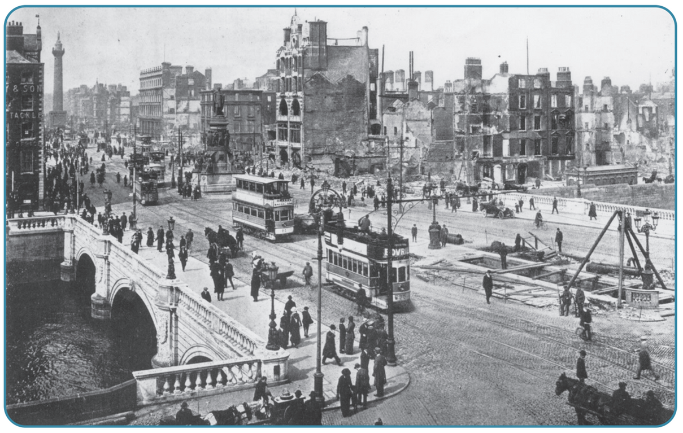
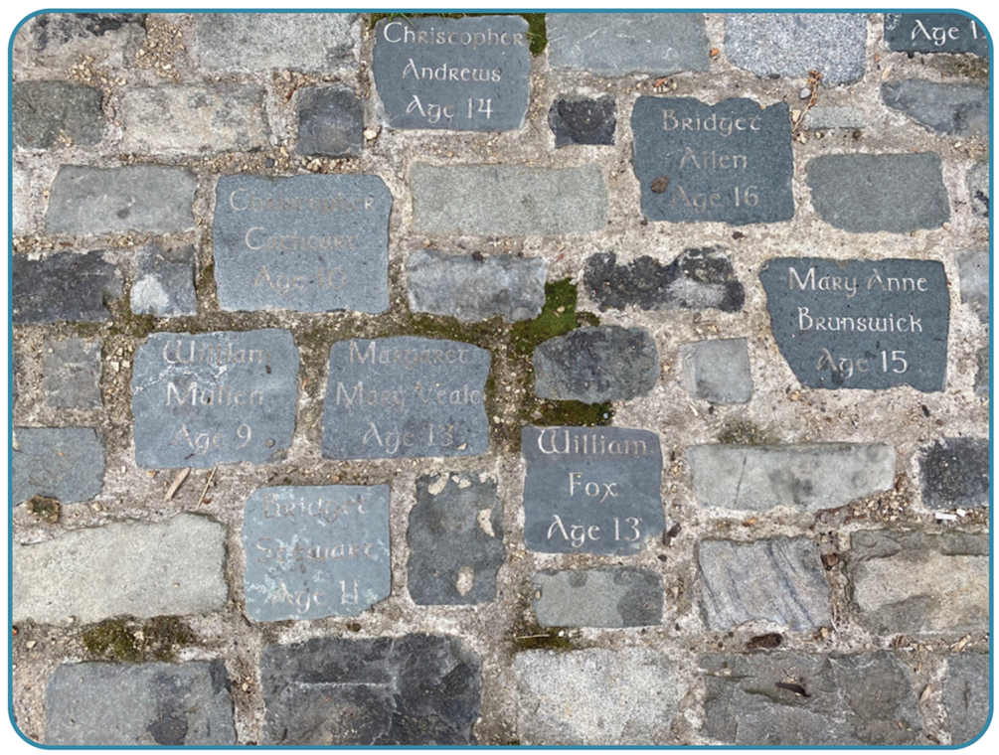
Strand Two: The History of Ireland
Chapter Twenty: The Struggle for Irish Independence
Diagram taken from Artefact, 2nd Edition by Eimear Jenkinson and Gregg O'Neill (educate.ie)
@MsDoorley

Slide 24
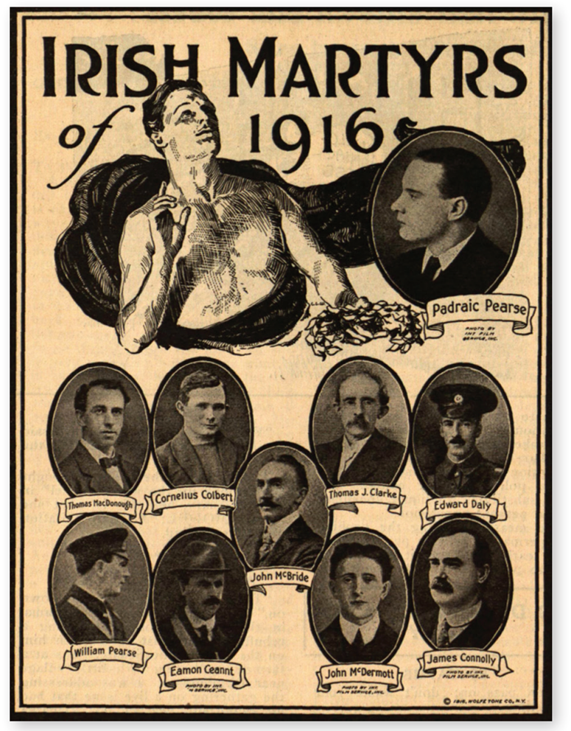
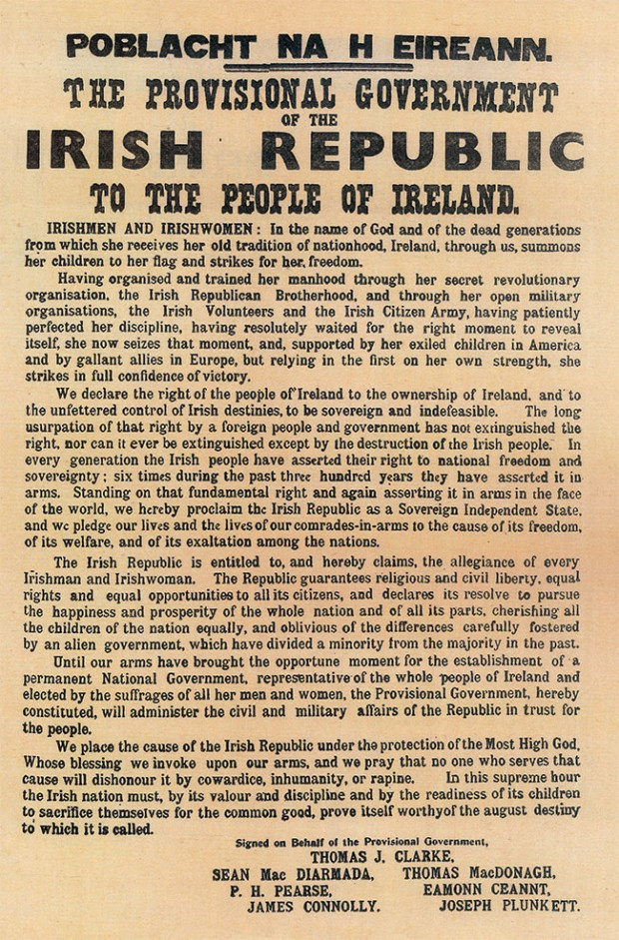
Strand Two: The History of Ireland
Chapter Twenty: The Struggle for Irish Independence
Diagram taken from Artefact, 2nd Edition by Eimear Jenkinson and Gregg O'Neill (educate.ie)
@MsDoorley

Slide 25
Checkpoint pg. 220 (Artefact, 2nd Edition)
  What damage was done by the Rising?
  How did the British treat (a) the rebels and (b) their leaders after the Rising?
  Why were the executions stopped?
  Why do you think the executions changed public opinion?
Strand Two: The Nature of History
Chapter Twenty: The Struggle for Irish Independence
@MsDoorley

Slide 26
1916-1923
Chapter 20
20.4: COMMEMORATING THE EASTER RISING
20.4: commemorating the easter rising
Strand Two: The History of Ireland
@MsDoorley

Slide 27


Commemorating the Easter Rising
A commemoration is a ceremony in which a person or an event is remembered. When we commemorate, we remember important events and people from our past that have helped to shape who we are today. Some commemorations can be controversial, especially when the events were violent or destructive, and above all when lives have been lost. It is important to find the right tone when marking an event of this kind; it is NOT a celebration - it is a respectful recognition that the event has had a significant impact for us and our lives. Commemorations can take many different forms. For example, there might be public services of remembrance, work by historians, monuments, cultural events or online events that remember those who took part in important historical events.
The Decade of Centenaries remembers and commemorates the events that took placed from 1912 to 1923, beginning with the signing of the Ulster Covenant in 1912 and ending with the end of the civil war in 1923. The year 2016 was the centenary (100 year anniversary) of the Easter Rising. Many commemorative events were held throughout the year all around Ireland to remember the people and events connected with the Rising. Although the Rising took place mainly in Dublin, communities elsewhere also marked the occasion since men and women from their villages/towns took part in Dublin and elsewhere during the Rising.
The Easter Rising is commemorated in Ireland because the efforts of the rebels and the reaction of the British convinced the majority of the Irish public to turn against British rule and to demand a full independence for Ireland. The Easter Rising has come to be seen as the first stage in a long and difficult process which transformed Ireland. The Easter Rising paved the way for Irish independence and all that has resulted from it over the past century.
Strand One: The Nature of History
Chapter Twenty: The Struggle for Irish Independence
@MsDoorley

Slide 28
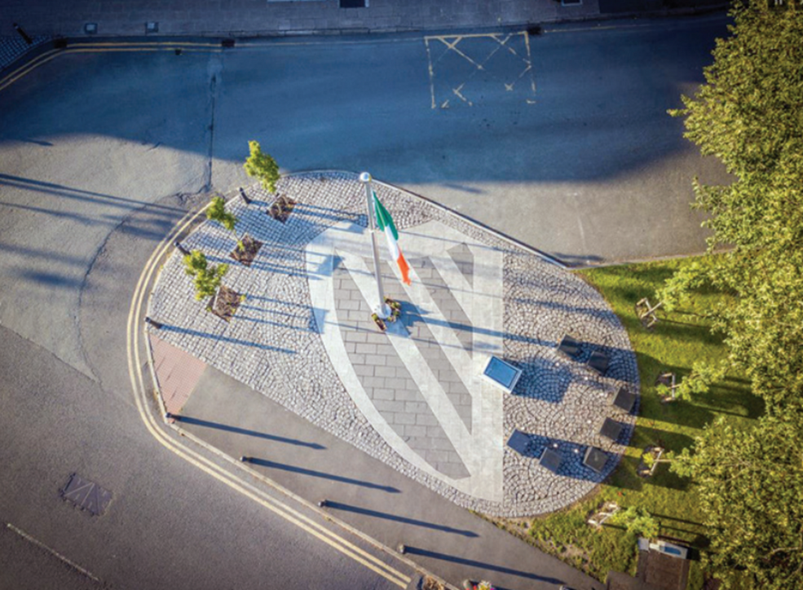
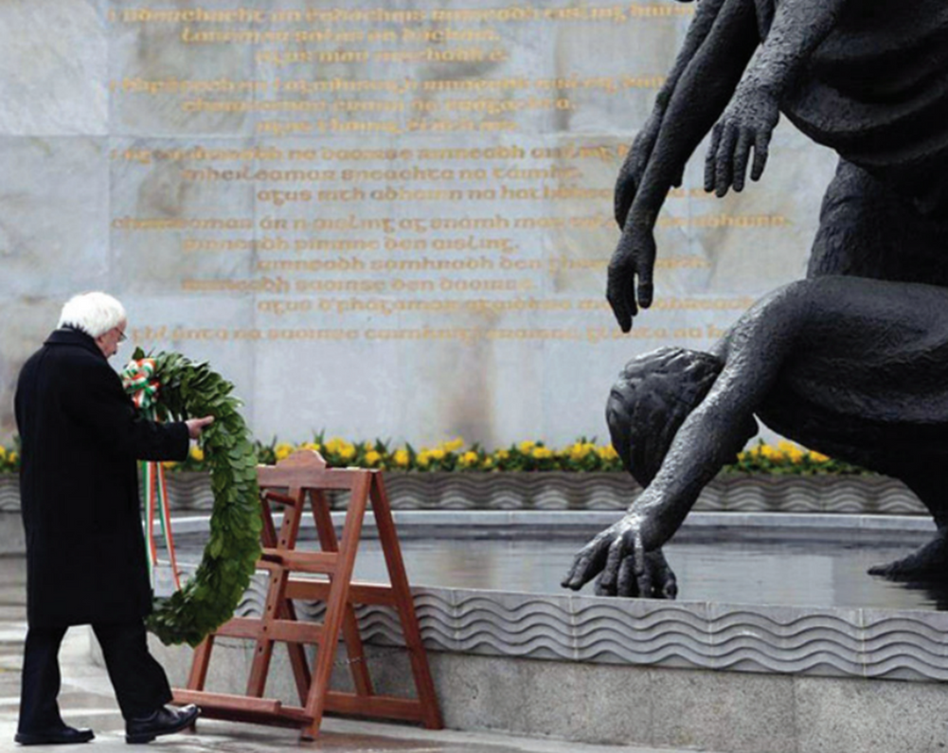
Strand One: The Nature of History
Chapter Twenty: The Struggle for Irish Independence
Diagram taken from Artefact, 2nd Edition by Eimear Jenkinson and Gregg O'Neill (educate.ie)
@MsDoorley

Slide 29
Checkpoint pg. 221 (Artefact, 2nd Edition)
  Explain the term commemoration.
  Why was the Rising commemorated in 2016?
  Do you think there might be any downsides in commemorating 1916?
Strand Two: The Nature of History
Chapter Twenty: The Struggle for Irish Independence
@MsDoorley

Slide 30
1916-1923
Chapter 20
20.5: THE RISE OF SINN FÉIN AND THE FIRST DÁIL
20.5: the rise of sinn féin and the first dáil
Strand Two: The History of Ireland
@MsDoorley

Slide 31
The Rise of Sinn Féin
  Sinn Féin was given recognition and credit for the Easter Rising in the newspaper at the time.
  In 1918 the electorate was expanded to all men over the age of 21, and for the first time, women over the age of 30 who owned property. Many of these younger people became drawn to the party, feeling that the Irish Parliamentary Party (IPP) was outdated.
  People were angered by the execution of the Rising leaders and became convinced that Home Rule would not be enough.
  Sinn Féin changed its aims in 1917 to: achieving the international recognition of Ireland as an independent Irish Republic.
  Sinn Féin won by-elections in 1917 and 1918, filling seats that were empty due to retirements and deaths during World War I.
  Éamon de Valera took over from Arthur Griffith as Sinn Féin leader in 1917 and was the only surviving commander from the Easter Rising.
  In 1918, the British government planned to introduce conscription to Ireland, causing the Conscription Crisis. Conscription is when it is made compulsory for men aged 18 and over to join the military for a period of time. All Irish parties opposed it but Sinn Féin managed their opposition well through propaganda.
  The German Plot was when members of Sinn Féin were arrested by the British government for allegedly plotting with the Germans – there was no evidence so the British were forced to do a U-turn.
Strand Two: The History of Ireland
Chapter Twenty: The Struggle for Irish Independence
@MsDoorley

Slide 32
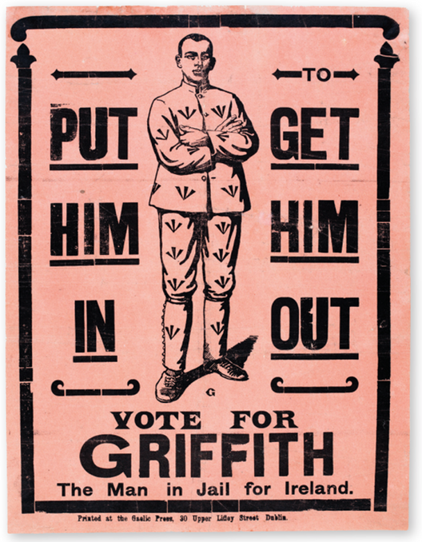
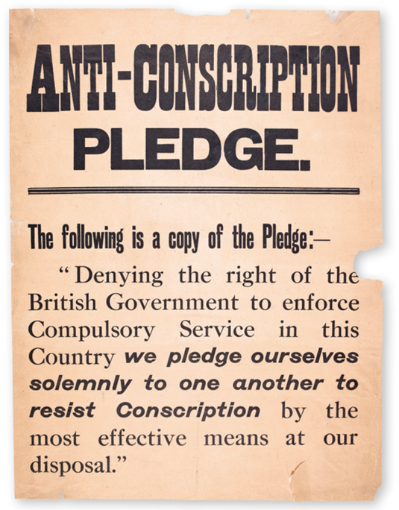
The 1918 General Election
A general election was held in December 1918 after the war ended. Of the 105 seats in Ireland, Sinn Féin won 73, Unionists won 23 and IPP won 6. These election results made it clear that people no longer wanted a Home Rule parliament but rather a republic with full independence from Britain. Sinn Féin decided to abstain from the parliament in Westminster and to form a government in Dublin instead. The Sinn Féin MPs called themselves teachtaí dála (TDs).
Strand Two: The History of Ireland
Chapter Twenty: The Struggle for Irish Independence
Diagram taken from Artefact, 2nd Edition by Eimear Jenkinson and Gregg O'Neill (educate.ie)
@MsDoorley

Slide 33
The First Dáil
Sinn Féin formed a government in Dublin in the Mansion House, Dawson St, on 21st January 1919. They named it Dáil Éireann (‘meeting of Ireland’). At the first meeting, only 27 TDs were present because the remainder were in jail or on the run. The Irish Parliamentary Party and the Unionists refused to attend. Cathal Brugha was chosen as president of the Dáil due to Griffith and de Valera being in jail. At its first meeting, the Dáil issued a Declaration of Independence, saying that they would establish ‘an Irish Republic and pledge ourselves and our people to make this declaration effective by every means at our command’.
At an April meeting, when more TDs were present after being released (or escaped) from jail, the new ministers were selected.
The Sinn Féin government began to make changes in Ireland to try to establish control.
  They gained control of local government.
  They founded Sinn Féin/Dáil courts to deal with people’s court cases and crimes.
  They organised loans to help run the new Dáil. Michael Collins raised a loan from the general public of £300,000. De Valera raised nearly $5 million from supportive Irish emigrants in the US.
The Dáil was declared illegal by the British government in late 1919. The British parliament passed the Government of Ireland Act 1920 in which there would be a Home Rule Parliament in Ulster and one for the rest of Ireland in Dublin. This Act effectively partitioned the island of Ireland into North Ireland and South Ireland. It was seen as a compromise by the British and Unionists but Sinn Féin rejected it, continuing to demand independence for the whole island.
Strand Two: The History of Ireland
Chapter Twenty: The Struggle for Irish Independence
@MsDoorley

Slide 34
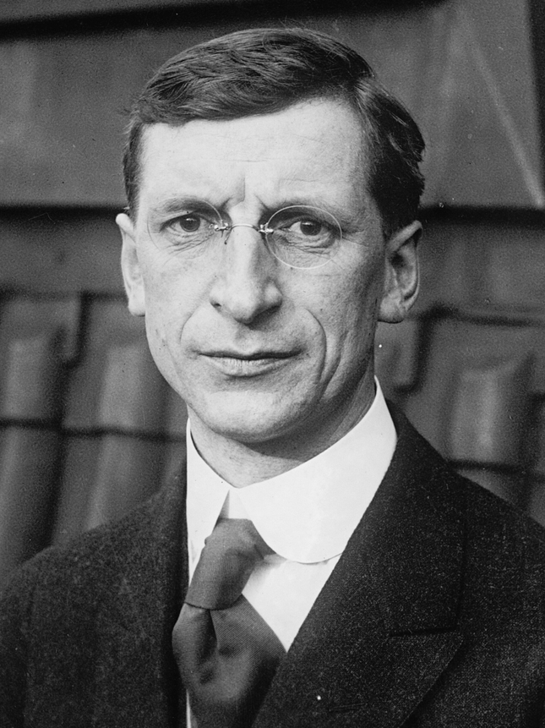
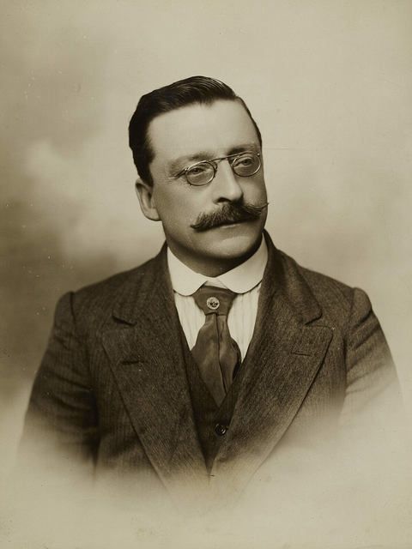
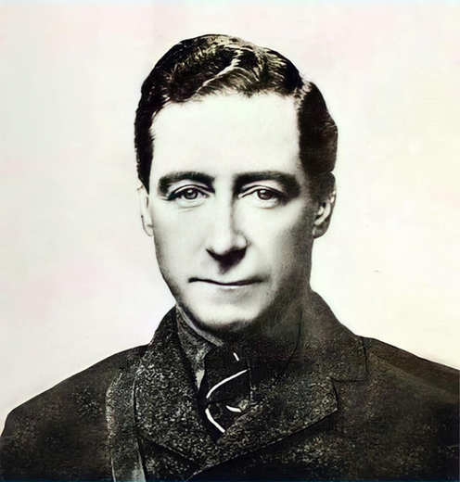
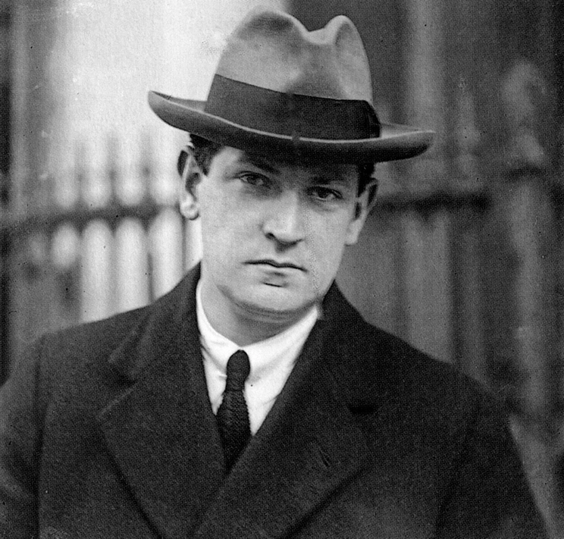
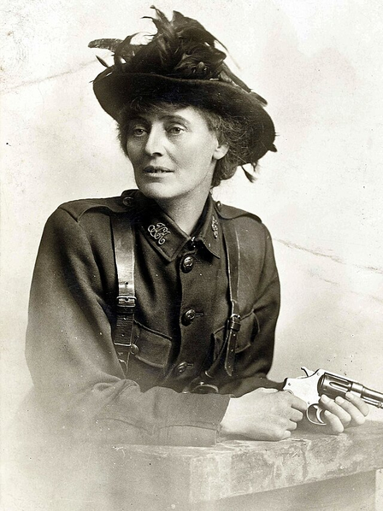
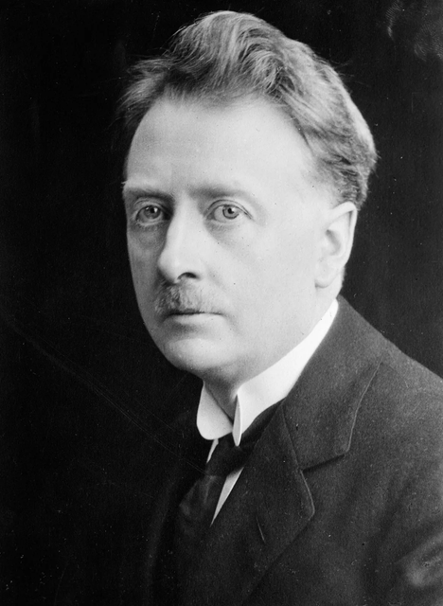
Éamon de Valera
Arthur Griffith
Cathal Brugha
Michael Collins
President of the Dáil
Minister for Home Affairs
Minister for Defence
Minister for Finance
Strand Two: The History of Ireland
Chapter Twenty: The Struggle for Irish Independence
Constance Markievicz
W.T Cosgrave
Eoin MacNeill
Minister for Labour
Minister for Local Government
Minister for Industries
Diagram taken from Artefact, 2nd Edition by Eimear Jenkinson and Gregg O'Neill (educate.ie)
@MsDoorley

Slide 35
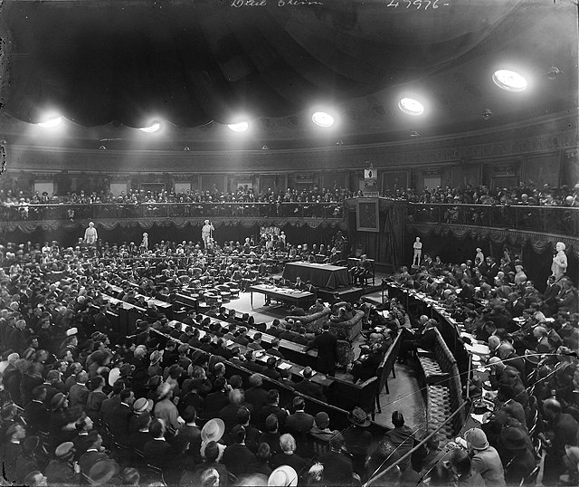
Strand Two: The History of Ireland
Chapter Twenty: The Struggle for Irish Independence
Diagram taken from Artefact, 2nd Edition by Eimear Jenkinson and Gregg O'Neill (educate.ie)
@MsDoorley

Slide 36
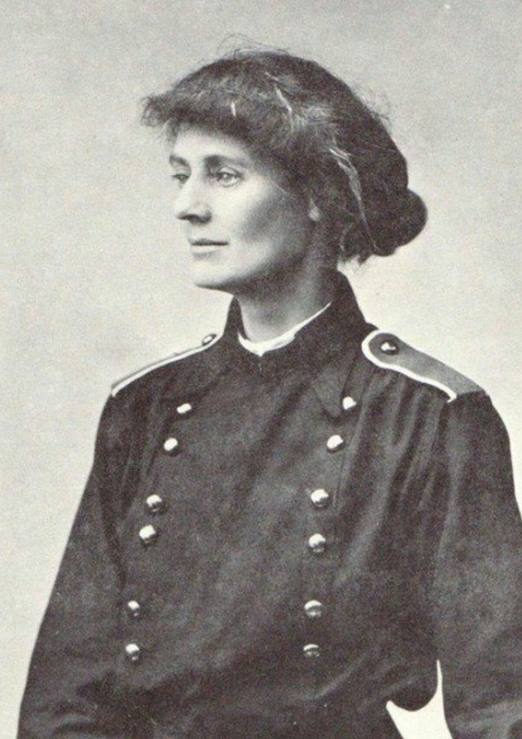
Countess Constance Markievicz, 1868-1927
Countess Constance Markievicz was born in London into the Anglo-Irish aristocracy and grew up at her family's estate, Lissadell, in Co. Sligo. In 1908, she joined the revolutionary women's group Inghinidhe na hÉireann ('Daughters of Ireland'), a republican youth organisation similar to the Scouts. She provided food for workers and their families during the 1913 Strike and Lockout. In April 1916, Markievicz took part in the Easter Rising and fought in St Stephen's Green. Her advice to female rebels thinking of taking up arms in 1916 was to 'dress suitably in short skirts and sitting boots, leave your jewels and gold wands in the bank, and buy a revolver'. She was arrested, imprisoned and sentenced to death. However, she was shown mercy 'solely and only on account of her sex'. In December 1918, while still serving time in prsion, Markievicz became the first woman ever elected to the House of Commons. She reused to swear an oath of allegiance to the King and so did not take her seat. Markievicz was against the Anglo-Irish Treaty and joined de Valera's Fianna Fáil party on its founding in 1926. She died in 1927 and is buried in Glasnevin Cemetary.
Strand Two: The History of Ireland
Chapter Twenty: The Struggle for Irish Independence
Diagram taken from Artefact, 2nd Edition by Eimear Jenkinson and Gregg O'Neill (educate.ie)
@MsDoorley

Slide 37
Checkpoint pg. 224 (Artefact, 2nd Edition)
  Explain the term conscription.
  How did Sinn Féin become associated with the Rising?
  What evidence is there that Sinn Féin became popular afterwards?
  How did the proposed plan for conscription impact on Ireland?
  Draw a pie chart to show the results of the 1918 General Eelection.
  When did the First Dáil take place?
  What does ‘Dáil Éireann’ mean?
  Name three ministers and give their positions in the First Dáil.
  How was money sources to run the Dáil?
  How did the Dáil try to establish its control of the Country?
  What was the Government of Ireland Act?
Strand Two: The Nature of History
Chapter Twenty: The Struggle for Irish Independence
@MsDoorley

Slide 38
1916-1923
Chapter 20
20.6: THE WAR OF INDEPENDENCE, 1919-1921
20.6: the war of independence, 1919-1921
Strand Two: The History of Ireland
@MsDoorley

Slide 39
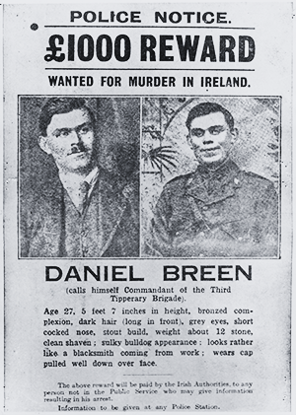
The outbreak of the War of Independence
The war of independence began on the 21st January 1919 on the same day that Dáil Éireann sat for the first time. A Royal Irish Constabulary (RIC) patrol were ambushed by a group of the Irish Volunteers, led by Dan Breen and Séan Treacy. The ambush was not authorised by the Dáil. Around the same time, the IRA (Irish Republican Army) were founded and declared the official army of the Irish Republic.
Strand Two: The History of Ireland
Chapter Twenty: The Struggle for Irish Independence
Diagram taken from Artefact, 2nd Edition by Eimear Jenkinson and Gregg O'Neill (educate.ie)
@MsDoorley

Slide 40
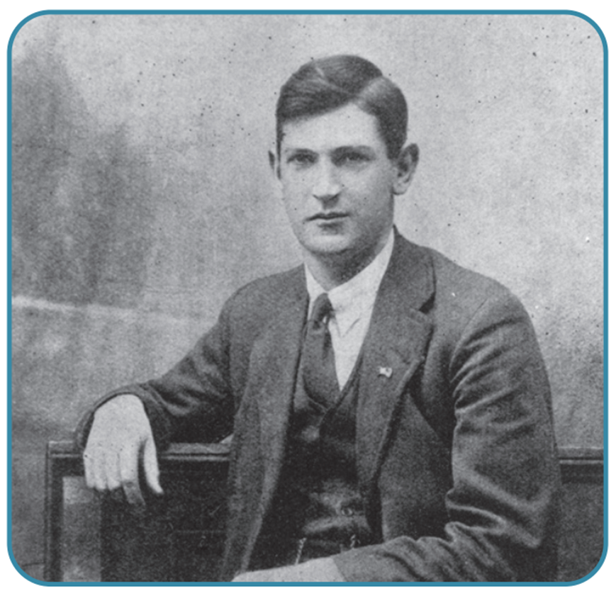
The methods of the IRA
The IRA used guerrilla warfare tactics against the British Forces. This involved the IRA members hiding in forests or civilian homes before ambushing travelling RIC patrols or British bases, stealing resources then running away.
Michael Collins was the Director of Intelligence in the IRA. He was in charge of a Dublin group called “The Squad” who were a group of assassins in charge of killing British authority figures in Ireland.
More local groups were called the “the flying columns” who were in charge of the ambushes of British forces such as police barracks and army stores.
Strand Two: The History of Ireland
Chapter Twenty: The Struggle for Irish Independence
Diagram taken from Artefact, 2nd Edition by Eimear Jenkinson and Gregg O'Neill (educate.ie)
@MsDoorley

Slide 41
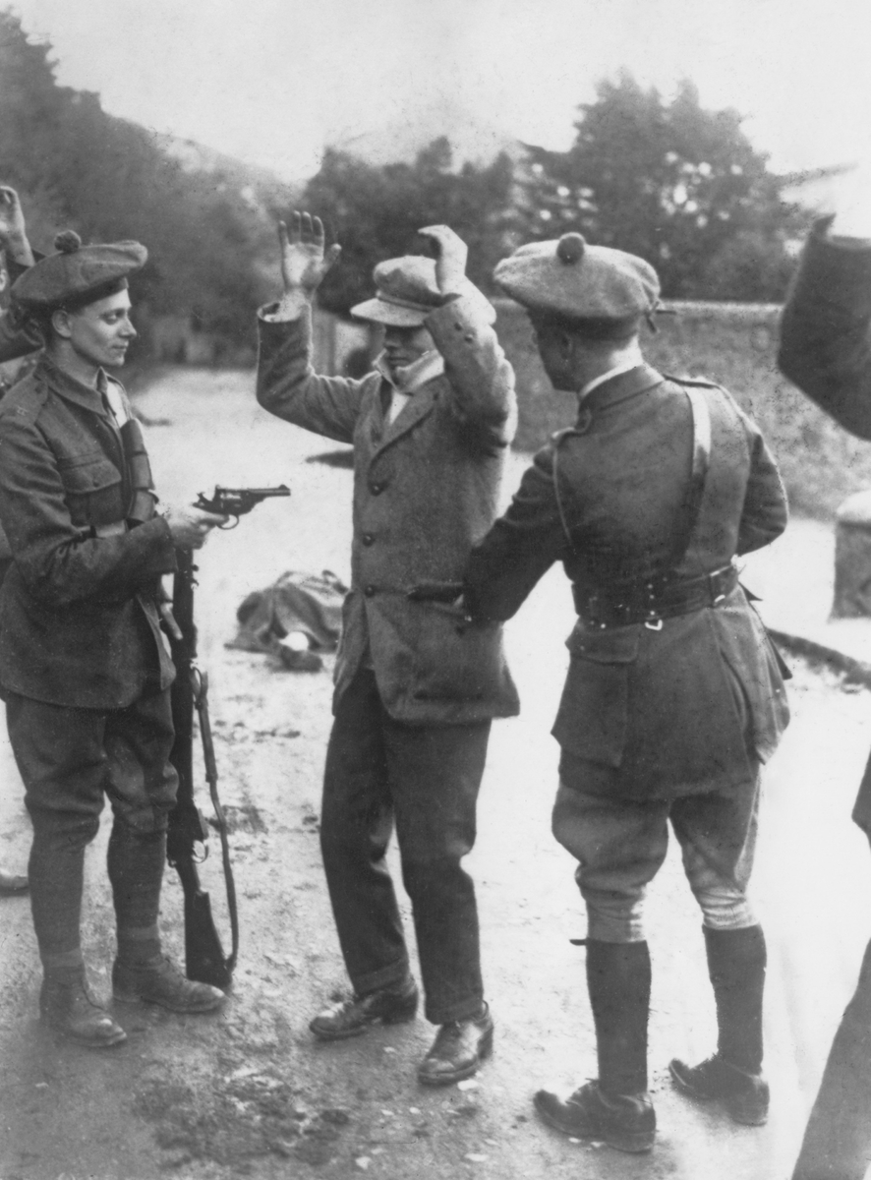
The methods of the British
The British Prime Minister at the time was David Lloyd George (a key figure in the end of World War I). The war in Ireland led to the formation of the Black and Tans in the Spring of 1920. They were made up of ex-British soldiers returning from World War I and the Second Boer War. Named after their uniforms, this group were particularly ruthless in strong IRA thresholds such as Cork and Derry.
A second group were recruited to help the RIC and Black and Tans, made up of ex-army officers. They were known as the Auxiliaries and were the most ruthless of the three British Forces based in Ireland.
By the end of 1920, British force numbers had risen to 40,000 compared to the 10,000 of the IRA.
For every action of the IRA, the Black and Tans, and thee Auxiliaries carried out terrible reprisals on Irish civilians which only increased support for the IRA.
Strand Two: The History of Ireland
Chapter Twenty: The Struggle for Irish Independence
Diagram taken from Artefact, 2nd Edition by Eimear Jenkinson and Gregg O'Neill (educate.ie)
@MsDoorley

Slide 42
Key events of the War of Independence
•20 March 1920 – British Forces murdered the Lord Mayor of Cork, Tomás MacCurtain, who had led the Cork Volunteers in the Easter Rising.
•25 October 1920 – Terence MacSwiney (Lord Mayor of Cork after MacCurtain) died in Brixton Prison, London after 74 days on hunger strike.
•1 November 1920 – Kevin Barry (18) was hanged for taking part in an ambush in Dublin which resulted in the death of a British Soldier.
•21 November 1920 – Bloody Sunday – Collin’s Squad kills13 British intelligence agents in the dawn hours. In retaliation, the Auxiliaries entered Croke Park and opened fire on the crowd, killing 12 people including Tipperary player Michael Hogan. The British are brought under fire in international relations for the attack.
•28 November 1920 – Tom Barry and the West Cork Brigade ambushed and killed 18 Auxiliaries in Kilmichael, Co. Cork; the Auxiliaries burn Cork City Centre in retaliation
•25 May 1921 – The IRA burn Custom House which lasted five days, destroying centuries of records. Eighty IRA men were killed or captured.
Strand Two: The History of Ireland
Chapter Twenty: The Struggle for Irish Independence
@MsDoorley

Slide 43
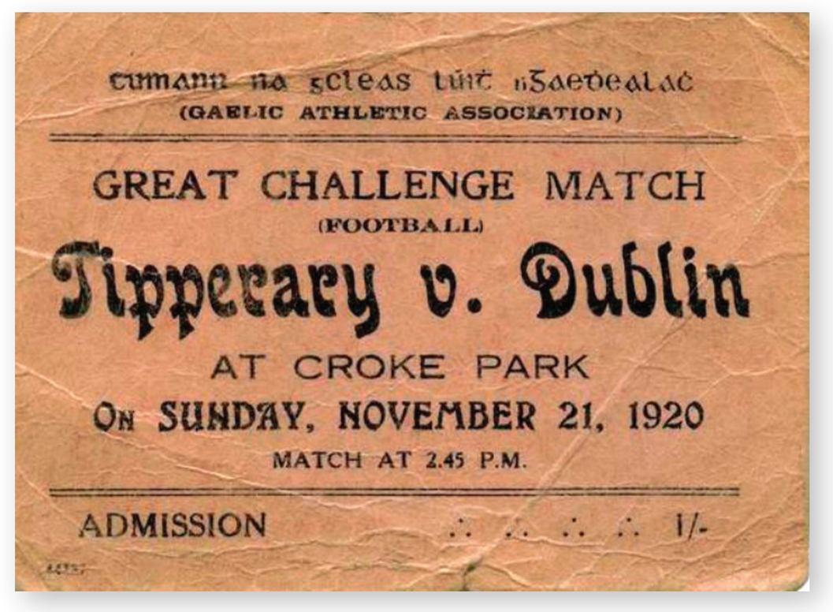
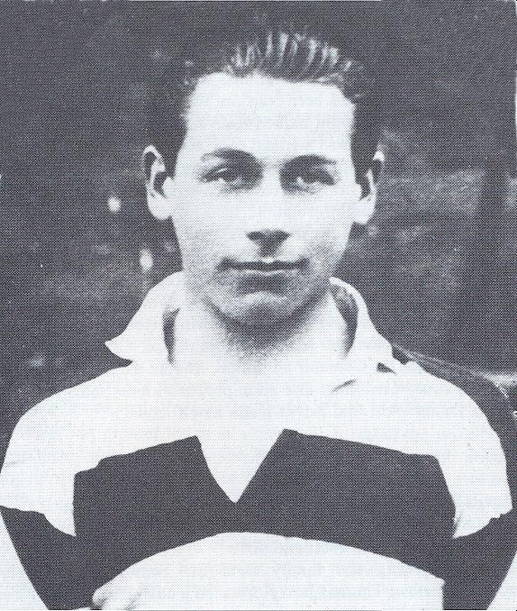
Strand Two: The History of Ireland
Chapter Twenty: The Struggle for Irish Independence
Diagram taken from Artefact, 2nd Edition by Eimear Jenkinson and Gregg O'Neill (educate.ie)
@MsDoorley

Slide 44
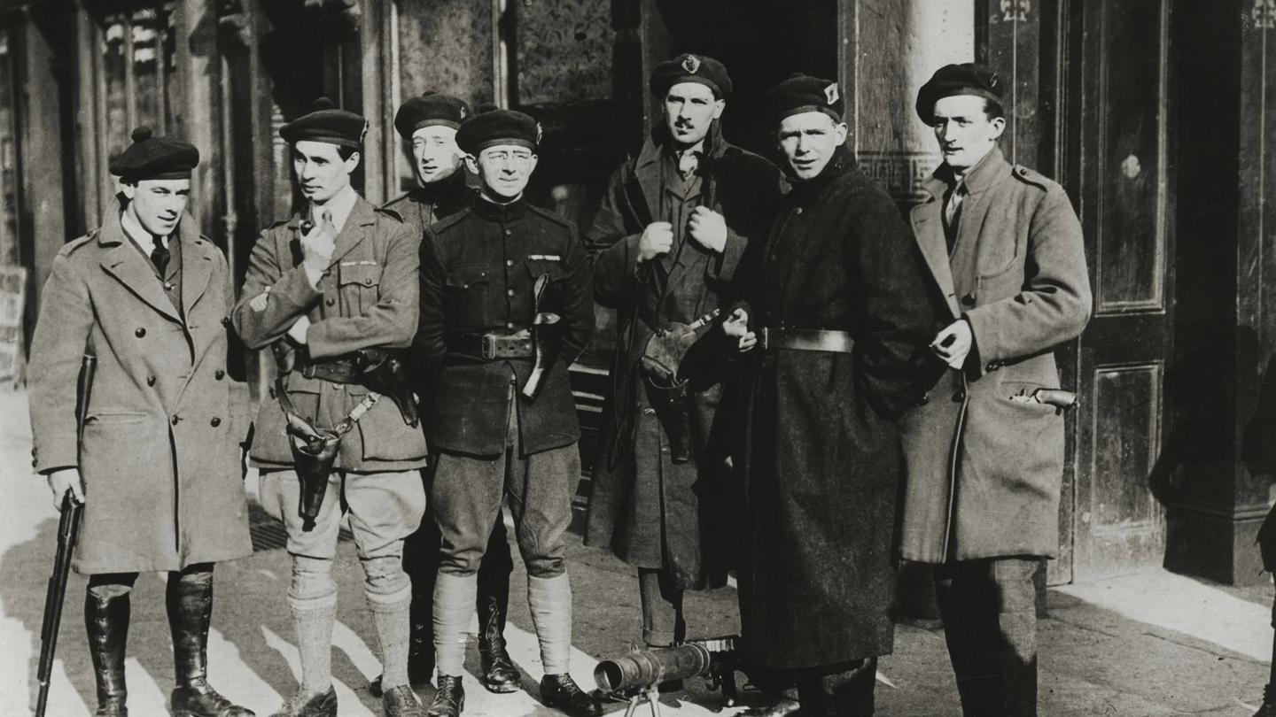
The End of the War
Both the Irish and British governments realised the need for peace as death tolls rose. The war cost Britain £20 million a year while the Irish were running out of arms and ammunition. The British were also under fire from home and international criticism for the actions of the Black and Tans, and the Auxiliaries against Irish civilians. A truce was agreed upon by Lloyd George and Eamon de Valera on the 11 July 1921.
Strand Two: The History of Ireland
Chapter Twenty: The Struggle for Irish Independence
Diagram taken from Artefact, 2nd Edition by Eimear Jenkinson and Gregg O'Neill (educate.ie)
@MsDoorley

Slide 45
Checkpoint pg. 226 (Artefact, 2nd Edition)
  When and how did the War of Independence begin?
  Explain the term guerrilla warfare.
  Who were (a) the Black and Tans and (b) the Auxiliaries?
  What was a reprisal?
  What was the bloodiest event of the War?
  Why was a truce declared in July 1921? (Give 3 reasons)
Strand Two: The Nature of History
Chapter Twenty: The Struggle for Irish Independence
@MsDoorley

Slide 46
1916-1923
Chapter 20
20.7: THE ANGLO-IRISH TREATY, 1921
20.7: the anglo-irish treaty, 1921
Strand Two: The History of Ireland
@MsDoorley

Slide 47
The Treaty Negotiations
Sinn Féin sent a delegation of Arthur Griffith, Michael Collins, Robert Barton, Éamonn Duggan and George Gavan Duffy to London with Erskine Childers serving as a secretary. Although the Irish delegation had been sent as plenipotentiaries (negotiators empowered to sign a treaty without reference back to their superiors), de Valera wanted information sent back to him before anything was signed, contradicting the status of the delegations. He also wanted to be in Ireland to deal with groups like the IRA if needed.
The British delegation comprised of Lloyd George, Winston Churchill, Austin Chamberlain and Lord Birkenhead. All four were very experienced compared to their Irish counterparts and had been involved in the negotiations of the Treaty of Versailles at the end of World War I.
Strand Two: The History of Ireland
Chapter Twenty: The Struggle for Irish Independence
What the Irish wanted: | What the British wanted:
A republic completely independent of Britain. | To keep Ireland within the British Empire.
No border/partition between North and South. | To protect the Ulster Unionists.
The negotiations lasted two months from October to December 1921. The Irish quickly realised a compromise was needed. They were in regular contact with de Valera and the government at home but were pressured by Lloyd George to accept a deal, with the threat of restarting the war if they refused.
De Valera had met with Lloyd George on four occasions at Downing Street in July 1921
Griffith and Collins accepted the deal laid out by the British. Both men felt that de Valera had set them up for failure, knowing there was an unpleasant compromise in store.
@MsDoorley

Slide 48
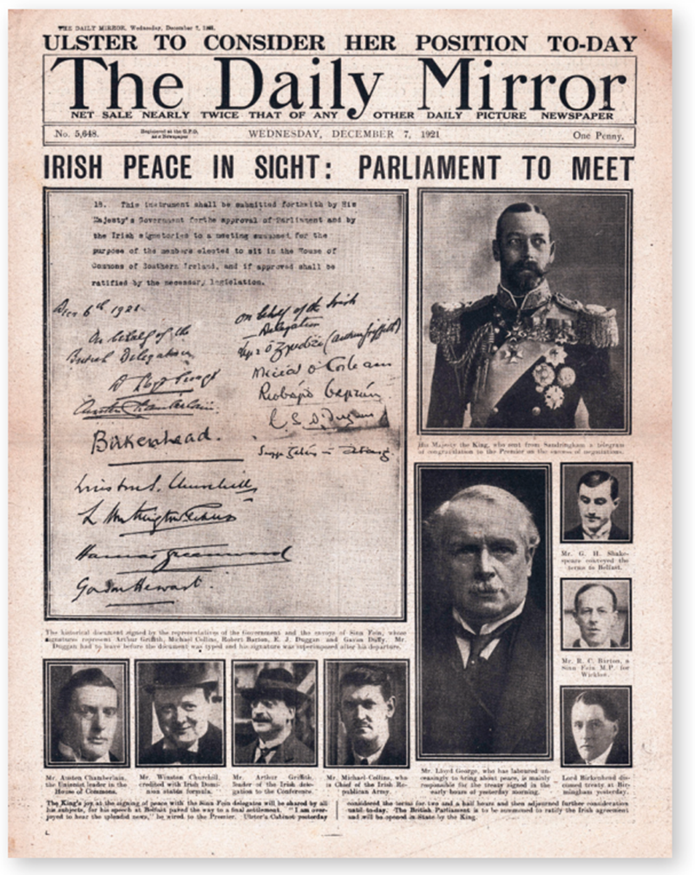
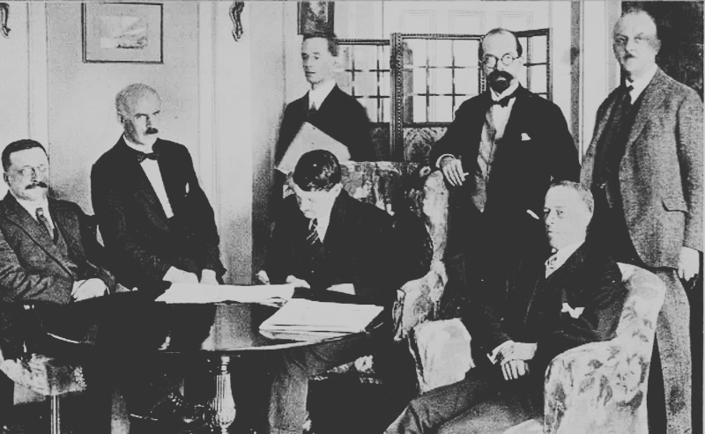
Strand Two: The History of Ireland
Chapter Twenty: The Struggle for Irish Independence
Diagram taken from Artefact, 2nd Edition by Eimear Jenkinson and Gregg O'Neill (educate.ie)
@MsDoorley

Slide 49
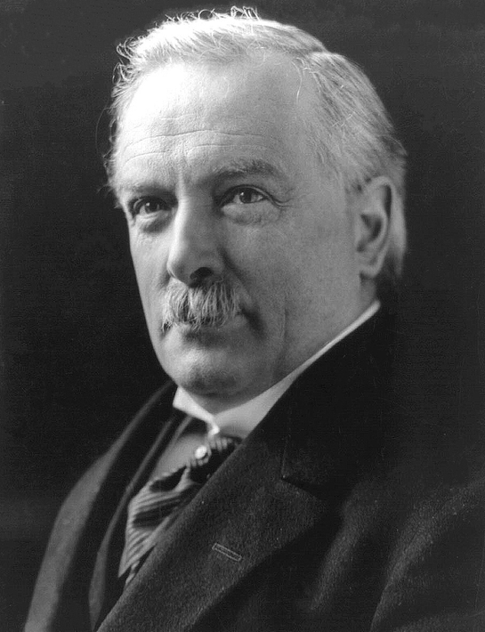
Terms of the Treaty
On the 6th December 1921, the 'Treaty between Great Britain and Ireland' (The 1921 Anglo-Irish Treaty) was signed. The main terms were:
  Ireland would not be a republic but a dominion (self-governing country within the British Empire). It would have its own parliament in Dublin but the British Monarch (King/Queen) would remain head of the State.
  Ireland would be called the Irish Free State.
  A governor-general would be the King’s representative in the Free State.
  All TDs would have to take an oath of allegiance to the British Crown.
  Britain would keep three naval ports in Ireland – Cobh, Berehaven and Lough Swilly.
  The Government of Ireland Act 1920 would stand, and Northern Ireland would have its own parliament.
  A boundary commission would be set up to decide the border between North and South.
Strand Two: The History of Ireland
Chapter Twenty: The Struggle for Irish Independence
Did you know?
After Michael Collins had signed the Treaty, he wrote in a letter: 'I tell you this - early this morning I signed my own death warrant'.
Diagram taken from Artefact, 2nd Edition by Eimear Jenkinson and Gregg O'Neill (educate.ie)
@MsDoorley

Slide 50
Reaction to the Treaty
The Treaty divided the people of Ireland. While many saw the Treaty as an end to fighting, others saw the Treaty as a sell out. The Dáil debated the Treaty from December 1921 to January 1922, splitting Sinn Féin and the IRA into two groups; Pro-Treaty (Griffith and Collins) and Anti-Treaty (de Valera).
The Pro-Treaty Side (Arthur Griffith, Michael Collins and W.T Cosgrave) | The Anti-Treaty Side (Éamon de Valera,Cathal Brugha and Austin Stack)
Main arguments: | Main arguments:
They could not fund a war against the British any longer. | They had not achieved the republic that they had fought and died for.
The Treaty could be built upon over time and was a stepping stone to full independence. | They should have achieved better terms.
The Treaty was an improvement from Home Rule. | Irish TDs should not have to swear an oath of allegiance to the Crown.
The Treaty guaranteed immediate peace with Britain. | The Treaty left Ireland partitioned.
Strand Two: The History of Ireland
Chapter Twenty: The Struggle for Irish Independence
The Treaty debates ended on the 7 January 1922 with the Pro-Treaty side winning by 64 votes to 57. De Valera resigned as President of the Dáil and left, his supporters following him. Arthur Griffith was elected in his place and a Provisional Government was set up to put the Treaty in place.
Diagram taken from Artefact, 2nd Edition by Eimear Jenkinson and Gregg O'Neill (educate.ie)
@MsDoorley

Slide 51
Checkpoint pg. 229 (Artefact, 2nd Edition)
  Who were the members of the Irish delegation? Which important figure did not attend the negotiations?
  Who were the members of the British delegation? What advantage(s) did they have over their Irish counterparts?
  When was the Treaty signed?
  What is a dominion? How was this more than Home Rule but less than a republic?
  What were the other main terms of the Anglo-Irish Treaty?
  What arguments were made by people who (a) supported and (b) opposed the Treaty?
Strand Two: The Nature of History
Chapter Twenty: The Struggle for Irish Independence
@MsDoorley

Slide 52
Checkpoint pg. 229 (Artefact, 2nd Edition)
  Members of the Irish delegation: Arthur Griffith, Michael Collins, Robert Barton, Éamonn Duggan, George Gavan Duffy, Erskine Childers and John Chartres; Éamon de Valera did not attend.
  Members of the British delegation: Lloyd George, Winston Churchill, Austin Chamberlain and Lord Birkenhead. Their advantage was their experience in politics and negotiation, having just negotiated the Treaty of Versailles at the end of World War I.
  The treaty was signed on 6 December 1921.
  Dominion: a self-governing country within the British Empire. This was more than Home Rule because Ireland would have its own parliament and be able to look after its own affairs – but the British king would remain the head of state, so it would remain less than a republic despite being called ‘the Irish Free State’.
  Other main terms of the Anglo-Irish Treaty: A governor-general would be the king’s representative in the Free State; all TDs would have to take an oath of allegiance to the British Crown; Britain would keep three naval ports in Ireland – Cobh, Berehaven and Lough Swilly; Northern Ireland would continue to stay in Britain; a boundary commission to establish a northern border would be set up.
  (a) Supporters believed they could not fund a war against Britain any longer; the Treaty could be built on over time and was a stepping stone to full independence; it was an improvement on Home Rule; it guaranteed immediate peace with Britain; (b) Those who opposed the Treaty felt they had not achieved the republic that they had fought for and died for; they should have achieved better terms; Irish TDs should not have to swear an oath of allegiance to the Crown; it left Ireland partitioned.
Strand Two: The Nature of History
Chapter Twenty: The Struggle for Irish Independence
@MsDoorley

Slide 53
1916-1923
Chapter 20
20.8: THE IRISH CIVIL WAR, 1922-1923
20.8: the irish civil war, 1922-1923
Strand Two: The History of Ireland
@MsDoorley

Slide 54
The Pro-Treaty and Anti-Treaty Divide
The Treaty split the country, Sinn Féin, the IRA, families and friends. A provisional government was set up and Arthur Griffith was elected President of the Dáil. The provisional government oversaw the withdrawal of British troops from Ireland before they formed a new government.
After the Dáil debates and vote, divisions between the two sides deepened. The Irish Free State Army (‘Regulars’) were IRA supporters of the Treaty. The Irregulars were the IRA members who were against the Treaty. In April 1922, Irregulars led by Rory O’Connor occupied the Four Courts and other buildings in Dublin in protest against the Dáil’s acceptance of the Treaty.
General Election Results, June 1922
Sinn Féin (Pro-Treaty) – 58
Sinn Féin (Anti-Treaty) – 36
The rest of the Pro-Treaty – 34 (Labour Party)
Total Pro-Treaty – 92
Total Anti-Treaty – 36
Strand Two: The History of Ireland
Michael Collins was commander-in-chief of the pro-Treaty Free State Army. He was reluctant to attack his former colleagues and friends until the general election in the June 1922.
Sinn Féin put forward both pro-Treaty and anti-Treaty candidates. In the end, 92 pro-Treaty Candidates to 36 anti-Treaty candidates were elected. This showed that a large majority of the people supported the Treaty, placing the government in a strong position.
Chapter Twenty: The Struggle for Irish Independence
@MsDoorley

Slide 55
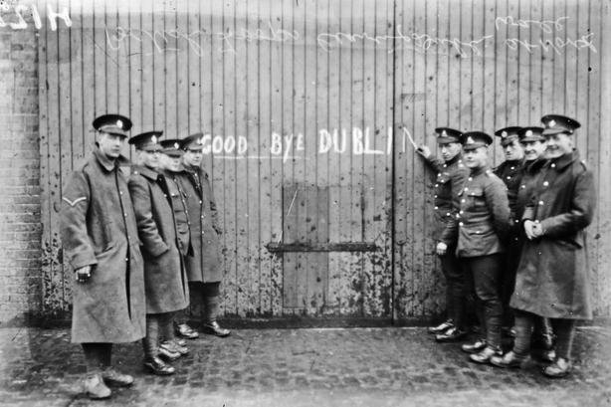
Strand Two: The History of Ireland
Chapter Twenty: The Struggle for Irish Independence
Diagram taken from Artefact, 2nd Edition by Eimear Jenkinson and Gregg O'Neill (educate.ie)
@MsDoorley

Slide 56
The Fighting Begins
In the same week, British Unionist Henry Wilson was assassinated and General O’Connell of the Free State Army was kidnapped. Believing the anti-Treaty IRA was behind the murder of Wilson, the British forced Collins to act, threatening that they would intervene if he did not. On the 28th June 1922, Collins began to attack the Four Courts with artillery borrowed from Britain: the Irish Civil War had officially begun.
Within two days, the Irregulars in the Four Courts had surrendered and within the week, they had given up the other buildings in Dublin City. Sixty-four people died in Dublin, including Cathal Brugha. Rory O'Connor was captured and replaced by Liam Lynch as Chief-of-Staff of the Irregulars. De Valera condemned the government’s actions and continued to support the anti-Treaty side.
The Irregulars retreated to Munster, where they had a lot of support. They gained control of many of the old RIC barracks and used guerrilla warfare tactics against the Free State Army. South of Limerick-Waterford line became known as the Munster Republic. A recruitment drive meant that the Free State Army grew to 60,000; greatly outnumbering the Irregulars. They drove them out of the barracks they had taken over. On the 12th August, Cork fell to the Free State Army and the Irregulars were forced to retreat to the countryside.
Strand Two: The History of Ireland
Chapter Twenty: The Struggle for Irish Independence
@MsDoorley

Slide 57
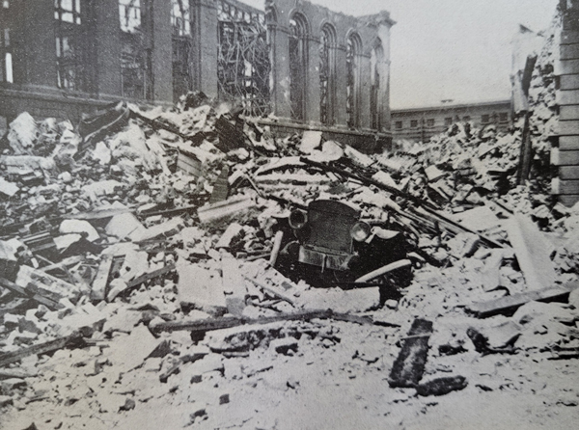
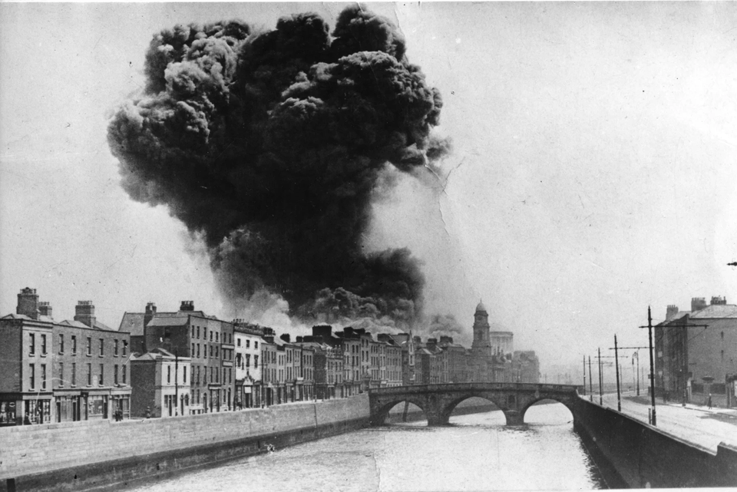
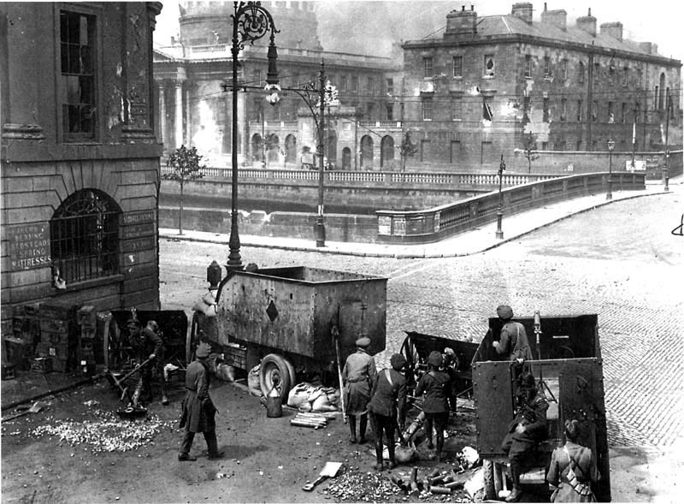
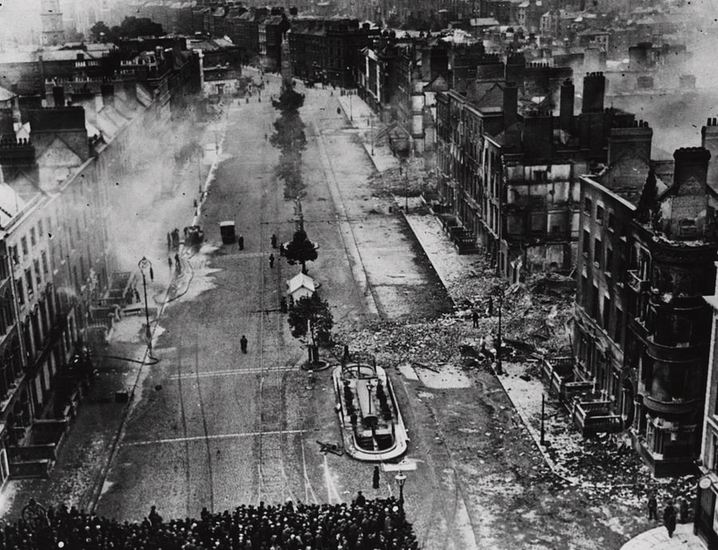
Strand Two: The History of Ireland
Chapter Twenty: The Struggle for Irish Independence
Diagram taken from Artefact, 2nd Edition by Eimear Jenkinson and Gregg O'Neill (educate.ie)
@MsDoorley

Slide 58
Checkpoint pg. 231 (Artefact, 2nd Edition)
  How did the Treaty affect Sinn Féin?
  Who were the (a) Regulars and (b) the Irregulars?
  What were the results of the 1922 election?
  What did these results mean?
  What event sparked the fighting in the Civil War?
  Describe the events in Dublin.
  What was the Munster Republic?
Strand Two: The Nature of History
Chapter Twenty: The Struggle for Irish Independence
@MsDoorley

Slide 59
1916-1923
Chapter 20
20.9: THE END OF THE CIVIL WAR
20.9: the end of the civil war
Strand Two: The History of Ireland
@MsDoorley

Slide 60
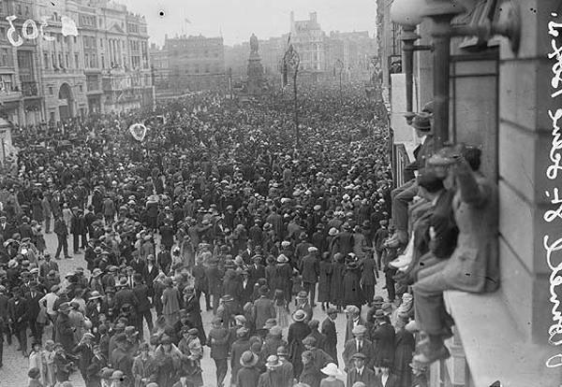
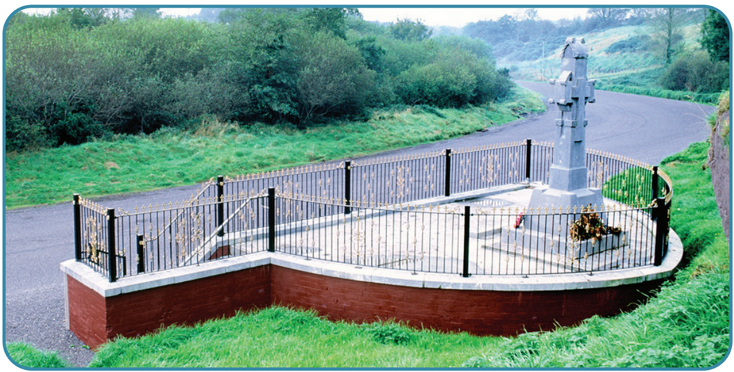
The deaths of Collins and Griffith
On the 12th August 1922, Arthur Griffith died suddenly of a brain haemorrhage at the age of 51. A founder of Sinn Féin, a chief negotiator of the Anglo-Irish Treaty and an instrumental member of the new Irish government, his death was a shock and a great loss for the new country.
Just ten days later, on the 22nd August 1922, Michael Collins was killed in an ambush in Béal na Bláth, between Bandon and Cork City while inspecting the Free State Army. His body was transported to Dublin by ship. His funeral, on the 28th August, was a huge public event, with up to half a million attendees. He was buried in Glasnevin Cemetery, like Griffith.
Griffith and Collins were mourned by people on both sides of the divide. Collins' death in particular had an effect on people who had once fought alongside him. Some, such as de Valera, believed that the bloodshed needed to end. After Collins' death, the Free State government took a harder line against the Irregulars.
Strand Two: The History of Ireland
Chapter Twenty: The Struggle for Irish Independence
Diagram taken from Artefact, 2nd Edition by Eimear Jenkinson and Gregg O'Neill (educate.ie)
@MsDoorley

Slide 61
The end of the Civil War
Following the deaths of Griffith and Collins, W.T Cosgrave became President of the Dáil and Kevin O’Higgins became Minister for Home Affairs (including law and order). The Civil War dragged on and became increasingly bitter – Kevin O’Higgins had Rory O’Connor executed having been O’Connor’s best man at his wedding only a year previously. In October 1922, the Public Safety Act of 1923 (also known as the Specials Power Act) was passed. This allowed the Free State government to arrest, try and imprison IRA members for a number of offences, or even to execute them: 12,000 Irregulars were arrested.
Fighting continued into 1923. Unlike the British during the War of Independence, the Free State Army had the advantage of knowing the countryside well. Liam Lynch, leader of the Anti-Treaty IRA, was killed in the Knockmealdown Mountains in April 1923. Frank Aiken replaced Lynch and, together with de Valera, called a halt to the violence in 1923 – there was no truce or treaty, simply a dumping of arms.
On the 24th May 1923, the Civil War came to an end through a ceasefire.
Strand Two: The History of Ireland
Chapter Twenty: The Struggle for Irish Independence
Diagram taken from Artefact, 2nd Edition by Eimear Jenkinson and Gregg O'Neill (educate.ie)
@MsDoorley

Slide 62


Strand Two: The History of Ireland
Chapter Twenty: The Struggle for Irish Independence
Diagram taken from Artefact, 2nd Edition by Eimear Jenkinson and Gregg O'Neill (educate.ie)
@MsDoorley

Slide 63

Michael Collins, 1890-1922
Michael Collins was born at Woodfield near Clonakilty, Co. Cork. He was given the nickname 'the Big Fellow'. Collins was a member of Sinn Féin and joined the IRB in 1909. In 1914, he became an Irish Volunteer and was the administrative assistant to Joseph Plunkett in the GPO, but he did not take part in the fighting. After the Rising, Collins was a prisoner of war in Stafford Prison (England) and Frongoch Prison (Wales). He was elected a Sinn Féin MP/TD in 1918. In 1919, Collins became the Minister for Finance. Collins was Director of Intelligence during the War of Independence and later a member of the Irish delegation at the Treaty negotiations with Britain. In April 1922, during the Civil War, Collins was commander-in-chief of the Pro-Treaty, Free State army. On 22nd August, Collins was killed in an ambush in Co. Cork. He lay in state for three days at City Hall before the funeral procession left for Glasnevin Cemetery.
Strand Two: The History of Ireland
Chapter Twenty: The Struggle for Irish Independence
Diagram taken from Artefact, 2nd Edition by Eimear Jenkinson and Gregg O'Neill (educate.ie)
@MsDoorley

Slide 64
The legacy of the Civil War
  Death and destruction: Up to 1,5000 people are thought to have been killed during the Civil War. Roughly €38 million of damage was caused to property, with the centre of Dublin needing to be rebuilt..
  A Divided Country: The Civil War caused great bitterness which poisoned Irish politics for generations to come. Families and friends had split across the pro-Treaty and anti-Treaty lines, solidified by the Civil War and its atrocities. To this day, Fine Gael, Fianna Fáil and Sinn Féin remain in bitter dispute about the course Ireland took after the Civil War. Under the boundary commission, the border between north and south was left unchanged, displeasing many.
  Lost leaders: The country lost some its best and ablest leaders, such as Collins and Griffith, when it needed them most.
  Political Developments: The two largest political parties in Ireland grew out of the Pro- and Anti-Treaty sides of Sinn Féin – Cumann na nGaedhael (later Fine Gael) came from the Free State side and Fianna Fáil from the Republican side. A constitution was written for the Irish Free State (Saorstát Éireann) in 1922 before it was replaced by Bunreacht na hÉireann in 1937. The parliament, as it stands in the present day, was set up. The Oireachtas (Parliament) was made up of the Dáil Éireann (lower house) and the Seanad (upper house). An Garda Síochána were also set up while the courts were reorganised (and still used today).
Strand Two: The History of Ireland
Chapter Twenty: The Struggle for Irish Independence
@MsDoorley

Slide 65


Strand Two: The History of Ireland
Chapter Twenty: The Struggle for Irish Independence
Diagram taken from Artefact, 2nd Edition by Eimear Jenkinson and Gregg O'Neill (educate.ie)
@MsDoorley

Slide 66
Checkpoint pg. 234 (Artefact, 2nd Edition)
  How did the deaths of Griffith and Collins affect the Civil War?
  Who replaced Arthur Griffith as President of the Dáil?
  What was the Specials Power Act?
  What was Cumann na nGaedheal?
  Name three of Cumann na nGaedheal's achievements.
  Why did the Civil War have a long legacy for Ireland?
Strand Two: The Nature of History
Chapter Twenty: The Struggle for Irish Independence
@MsDoorley

Slide 67
Checkpoint pg. 234 (Artefact, 2nd Edition)
  Griffith and Collins were mourned deeply by members of both the pro-Treaty and anti-Treaty sides. Collins’s death in particular convinced many that the bloodshed needed to end.
  W. T. Cosgrave.
  The Special Powers Act was an act that allowed the government’s forces to arrest, try and imprison – or even execute – IRA members for a number of offences.
  The pro-Treaty side renamed themselves Cumann na nGaedheal (‘the Union of the Irish’).
  Any three of: a constitution was written for the Irish Free State (called ‘Saorstát Éireann’); a parliament called the Oireachtas, made up of the Dáil and the Seanad, was set up; an Garda Síochána was established; the courts system was reorganised.
  The two largest political parties in Ireland today have their roots in the Treaty politics of that time. Cumann na nGaedheal (later Fine Gael) arose from the pro-Treaty side and Fianna Fáil was formed from the anti-Treaty side.
Strand Two: The Nature of History
Chapter Twenty: The Struggle for Irish Independence
@MsDoorley

Slide 68
1916-1923
Chapter 20
20.10: SUMMARY
20.10: summary
Strand Two: The History of Ireland
@MsDoorley

Slide 69
In this chapter, we have learned that...
  The 1916 Rising was organised by a secret military council while Britain was absorbed by World War I. The 'Castle Document' was forged to convince Eoin MacNeill to involve the Irish volunteers.
  Arms from Germany were lost when the Aud was sunk while evading capture by the British navy.
  The Rising still went ahead, but in fewer locations and weapons than planned, and on Easter Monday instead of Sunday. It was based mainly in Dublin city centre.
  The British brought soldiers in from the Curragh and England and used a gunboat called the Helga to shell the GPO from the Liffey.
  Pádraig Pearse surrendered on behalf of the rebels: the Rising was over by Monday 1st May 1916.
  Almost 500 people were killed and over 2,500 injured, and buildings and property suffered heavy damage. Almost 3,000 people were sent to prisons in Britain, 90 leaders were sentenced to death. Fifteen of these were shot between 3rd and 12th May: 14 in Kilmainham Gaol and 1 in Cork.
  Sinn Féin rose in popularity and won 73 of 105 seats in the 1918 General Election. The party abstained from attending Westminster and formed a Dublin government (Dáil Éireann) in the Mansion House, Dawson St, on 21st January 1919.
  The War of Independence began that same day, on 21st January 1919, with the ambush of an RIC unit in Tipperary. The Irish used guerrilla warfare, the Squad and the Flying Columns. The British brought in the Black and Tans and the Auxiliaries. A truce was called on 11th July 1921.
Strand Two: The History of Ireland
Chapter Twenty: The Struggle for Irish Independence
@MsDoorley

Slide 70
In this chapter, we have learned that...
  Negotiations began in London in October 1921. The Irish delegation was led by Arthur Griffith and Michael Collins, while the British delegation included David Lloyd George and Winston Churchill. On 6th December 1921 they signed the Anglo-Irish Treaty.
  The Dáil debated the Treaty from December 1921 until January 1922 and split into a pro-Treaty side and an anti-Treaty side. On 7th January 1922, the Treaty was accepted by 64 votes to 57.
  The IRA also split into pro-Treaty members (known as the Irish Free State Army, or Regulars) and anti-Treaty members (Irregulars).
  The Irish Civil War began on 28th June 1922 when Michael Collins shelled the Four Courts, then occupied by the Irregulars under Rory O'Connor.
  Arthur Griffith and Michael Collins both died in August 1922. They were mourned by members of both pro-Treaty and anti-Treaty sides.
  W.T. Cosgrave became President of the Dáil and Kevin O'Higgins became Minister for Home Affairs, including law and order. The Public Safety Act allowed a sharp crackdown.
  The Civil War ended on 24th May 1923. It had caused many deaths and bitter local divisions, and would shape Irish political divisions into the future.
Strand Two: The History of Ireland
Chapter Twenty: The Struggle for Irish Independence
@MsDoorley

Slide 71
Reflecting on... The Struggle for Irish Independence
Nationalism and unionism both continued their rise between 1914 and 1923. Nationalism went from its goals of Home Rule via the Easter Rising, a declaration of statehood and the War of Independence to having Sinn Féin in the Dáil, showing the growth of nationalist ideas during this time. Unionists had a form of Home Rule as a result of the Government of Ireland Act 1920 and the Unionist Party remained in power in Northern Ireland. The events of 1916-1923 continue to have a huge impact on Ireland: generations on both sides of the border are still influenced by these events, and political parties and beliefs stemming from this period are still in existence.
Strand Two: The History of Ireland
Chapter Twenty: The Struggle for Irish Independence
@MsDoorley

Slide 72
SEC Examination Questions
2021 SEC Sample Q6 - Easter Rising
2022 SEC Q6 - Civil War
2023 SEC Q4 - Easter Rising
Strand Two: The History of Ireland
Chapter Twenty: The Struggle for Irish Independence
@MsDoorley

Slide 73
Project
Guidelines:
  Length: The depth of your project should reflect about 2-3 weeks of work.
  Sources: Use at least three different sources for your research. These can be books, scholarly articles, or reputable online resources.
  Citations: All information and images that are not your own should be properly cited.
  Mediums: You may choose to present your project in one of the following ways:
    Poster: Your poster should be informative and visually engaging.
    Minecraft or Lego Model: If choosing this option, please also include a brief report explaining your model.
    Painting/Drawing: Your artwork should be accompanied by a description.
    Recycled Materials: Create your model using recycled materials and provide an explanation of your creative process.
Assessment:
Your projects will be assessed based on:
  Research and Content
  Creativity and Presentation
  Understanding of Context
  Adherence to Guidelines
Strand Two: The History of Ireland
Chapter Twenty: The Struggle for Irish Independence
@MsDoorley

Slide 74
Project
Historical Sites
Historical Figures
General Post Office, Dublin, Republic of Ireland
Kilmainham Gaol, Dublin, Republic of Ireland
Béal na Bláth, County Cork
Custom House, Dublin, Republic of Ireland
Four Courts, Dublin, Republic of Ireland
Eoin MacNeill
James Connolly
Patrick Pearse
Thomas Clarke
Seán MacDiarmada
Thomas MacDonagh
Countess Markievicz
Mary MacSwiney
Éamon de Valera
Michael Collins
Arthur Griffith
Tom Barry
Terence MacSwiney
Tomás Mac Curtain
Elizabeth Farrell
Liam Lynch
Roger Casement
Kathleen Lynn
Strand Two: The History of Ireland
Chapter Twenty: The Struggle for Irish Independence
@MsDoorley

